Slide 1
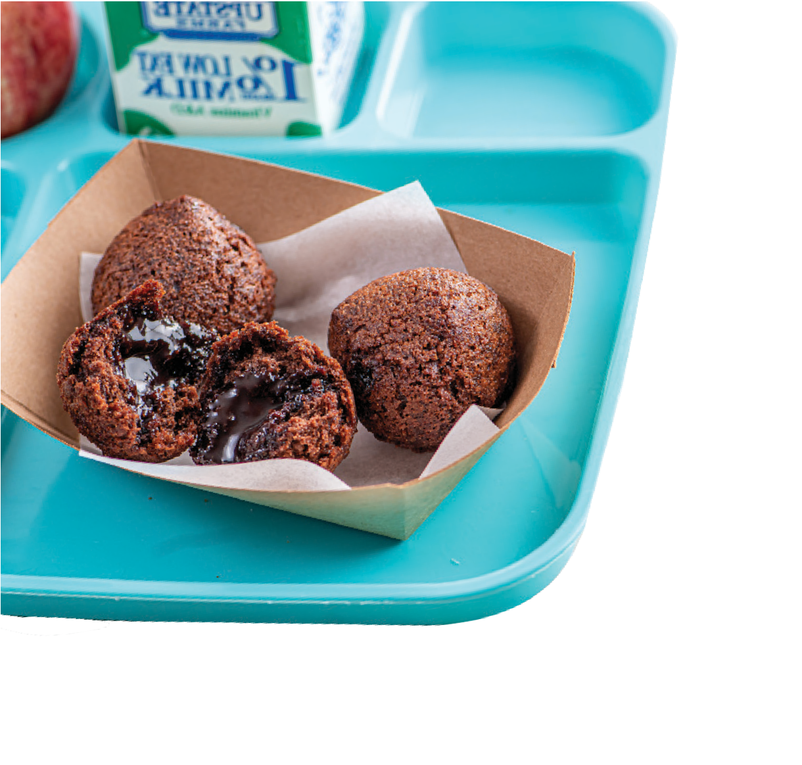
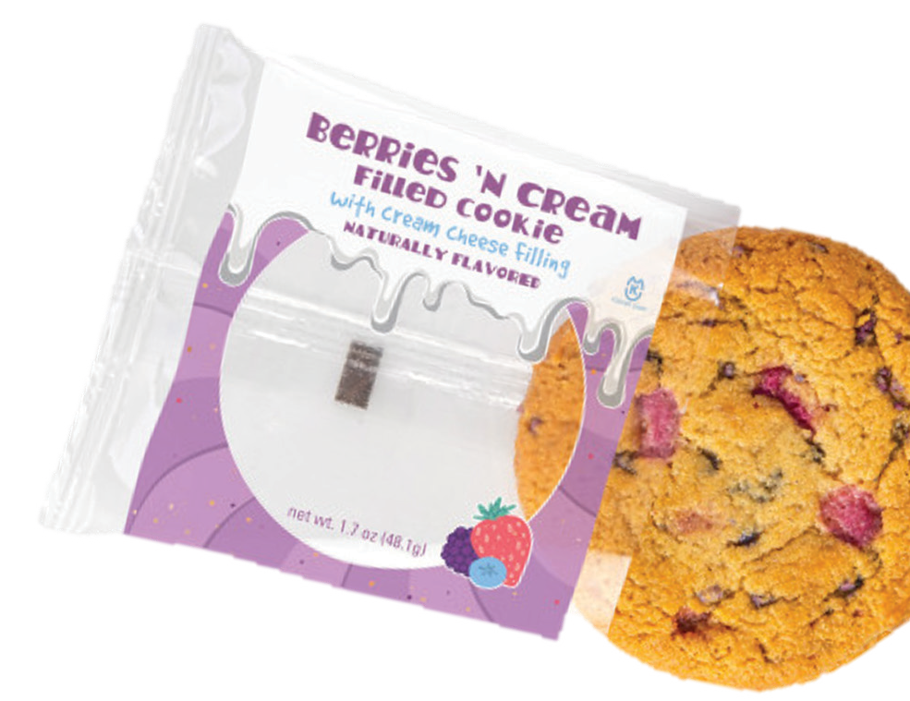
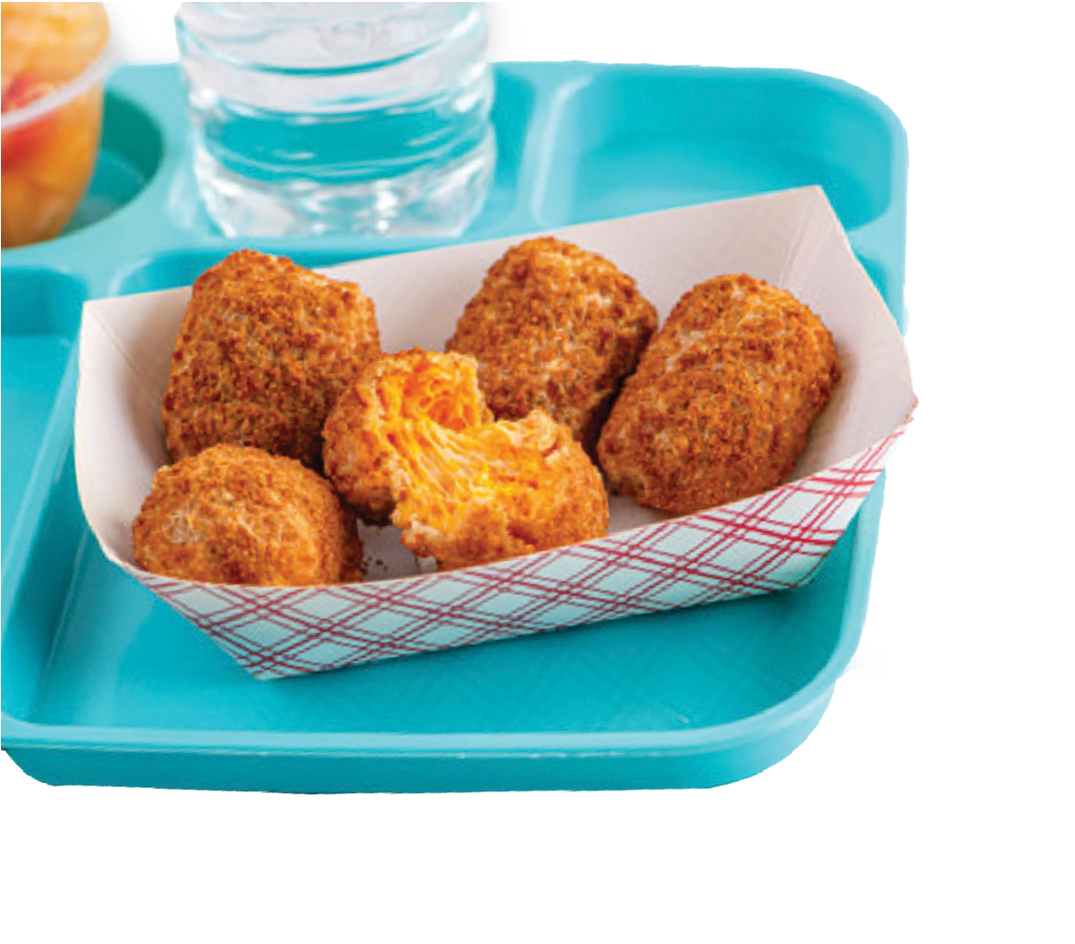
NEW YEAR,
NEW K-12 INNOVATIONS
Available for 2024-2025 School Year.
PRODUCT CODE
PRODUCT DESCRIPTION CASE/PACK
WGR Double Chocolate _{220/1.3 oz.}
MEAL CREDITING
23564
Ganache Filled Bites
3 Pieces =
2 oz Grain eq
PRODUCT CODE
PRODUCT DESCRIPTION
CASE/PACK
MEAL CREDITING
23365
WGR Berries & Cream Filled IW Cookie
220/1.3 oz. ^{1 Piece =}
1 oz Grain eq
PRODUCT CODE
PRODUCT DESCRIPTION
CASE/PACK
MEAL CREDITING
23400 Cheesy Mac Bite
6/5 lb
5 Pieces =
3 oz Grain eq & 2 oz MMA
3 Pieces =
2 oz Grain eq & 1 oz MMA
For more information, please contact:
Tracye Friedman - K-12 KAM Mid-Atlantic I tfriedman@rich.com I 443-519-9453

Slide 2
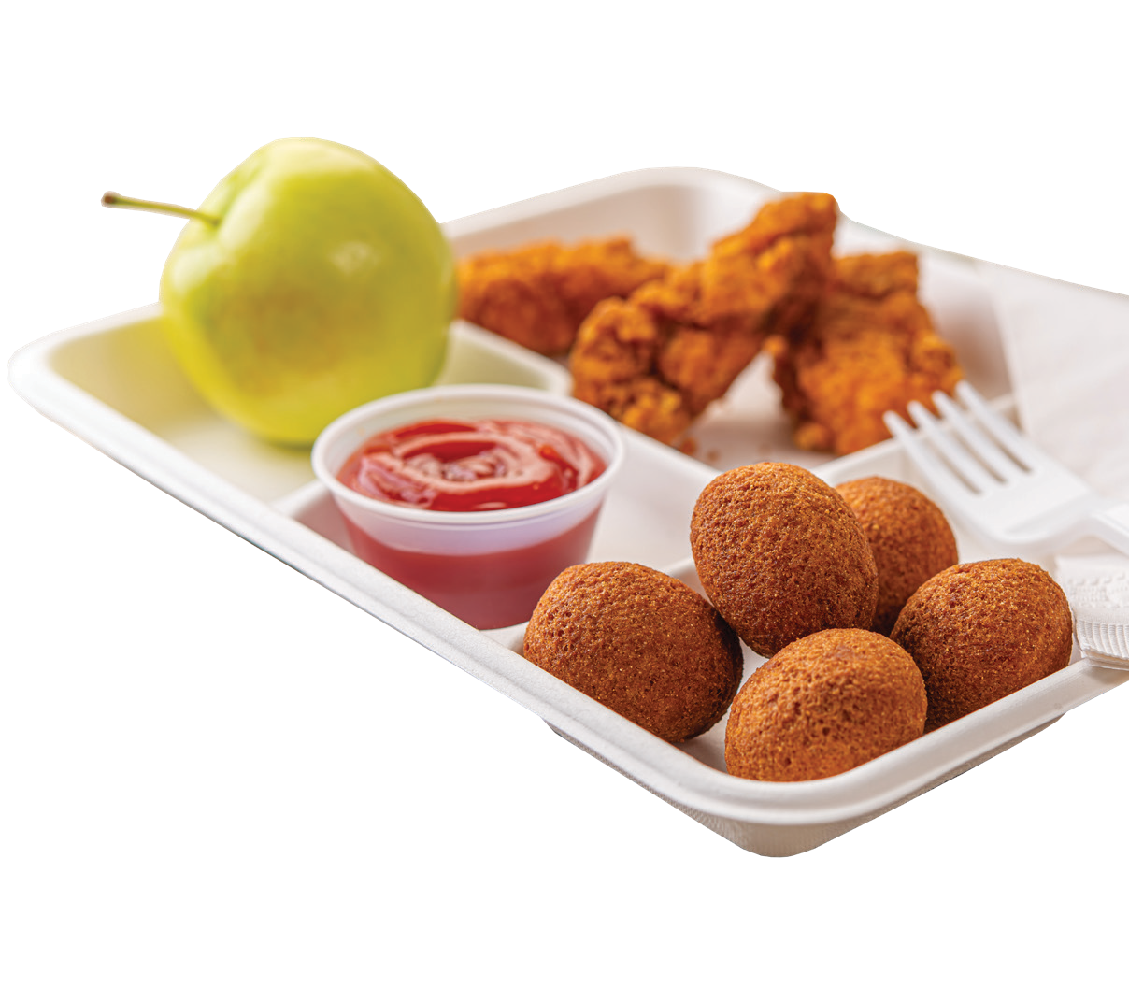
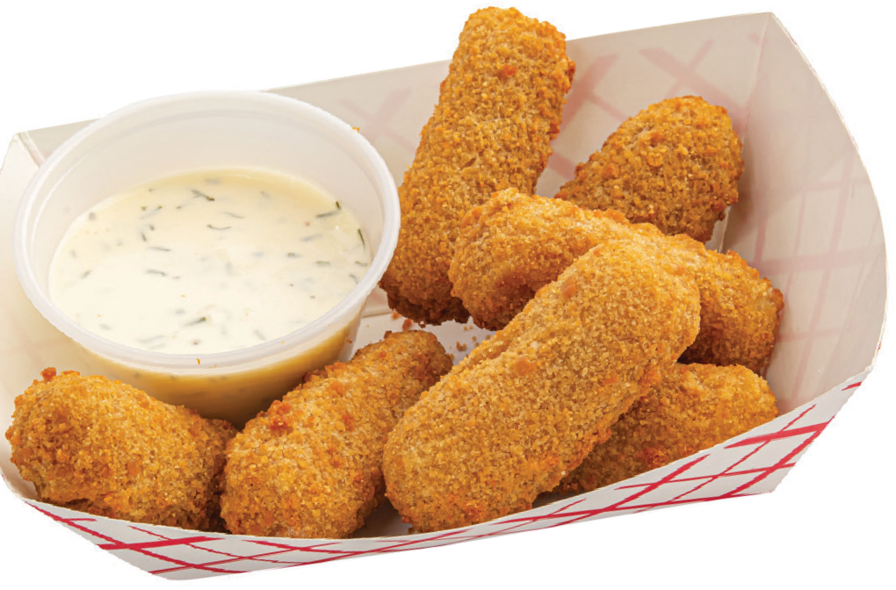
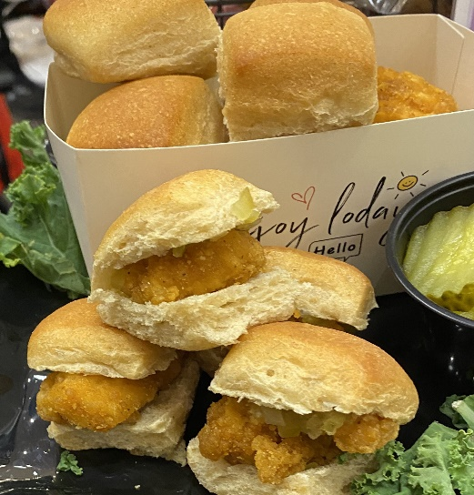
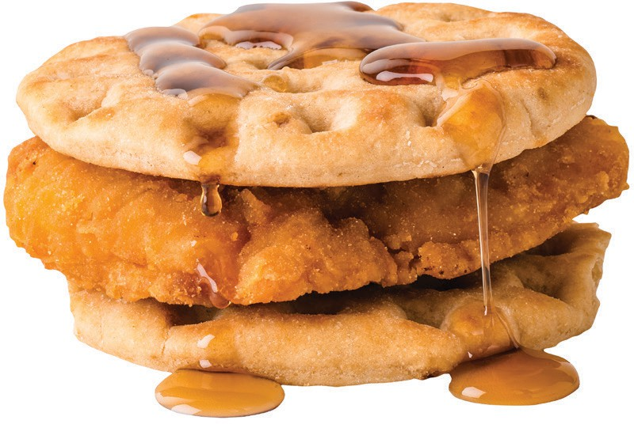
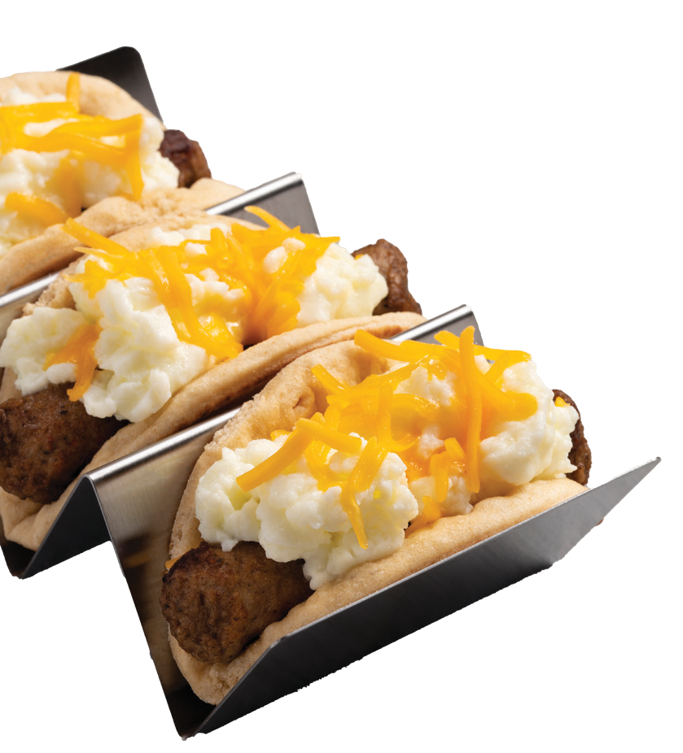
PRODUCT CODE
PRODUCT DESCRIPTION
CASE/PACK
MEAL CREDITING
18510
WGR Cornbread Poppers
384/0.51 oz
6 Pieces =
2 oz Grain eq
Available for 2024-2025 School Year.
PRODUCT CODE
PRODUCT DESCRIPTION
CASE/PACK
MEAL CREDITING
Farm Rich WGR 19864 Jalapeño Mozzarella
Bites
8/3 lb
7 Pieces =
2 oz Grain eq and 2 oz MMA
PRODUCT CODE
PRODUCT DESCRIPTION
CASE/PACK
MEAL CREDITING
16206
WGR Hawaiian Roll Dough
240/1.50 oz
1 Piece =
1 oz Grain eq
PRODUCT CODE
PRODUCT DESCRIPTION
CASE/PACK
MEAL CREDITING
17279 WG Waffle Flatbread 48/4.9 oz
1 Piece =
1 oz Grain eq
For more information, please contact :
Tracye Friedman - K-12 KAM Mid-Atlantic I tfriedman@rich.com I 443-519-9453

