Slide 1
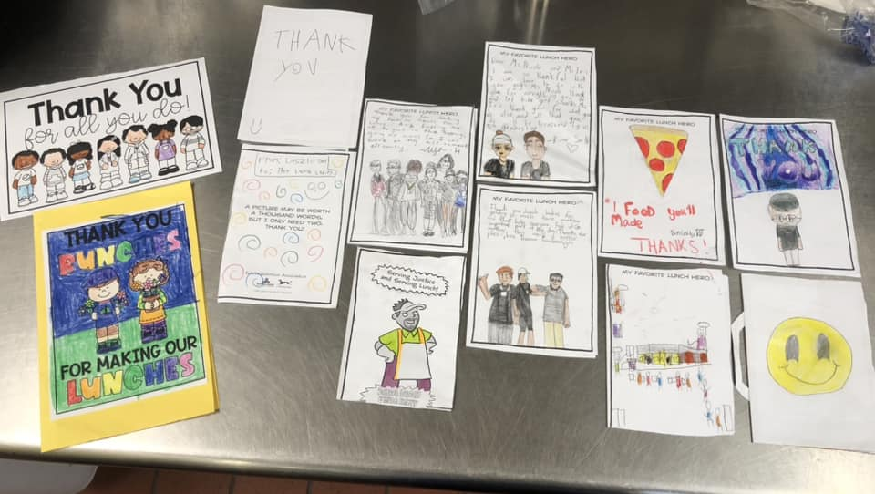
Tell your story
Take and Share School Meal Photos
#SPSCreatesAchievers
Angela Howell
Friday, March 14, 2025
12:45-1:30pm
Suffolk Public Schools
Notes:
SPS hori

Slide 2
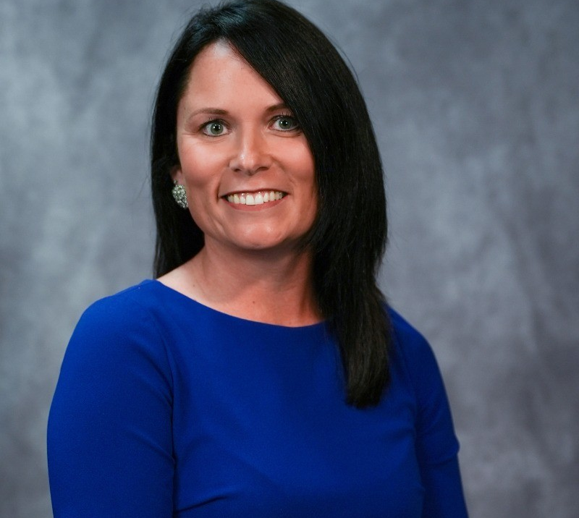
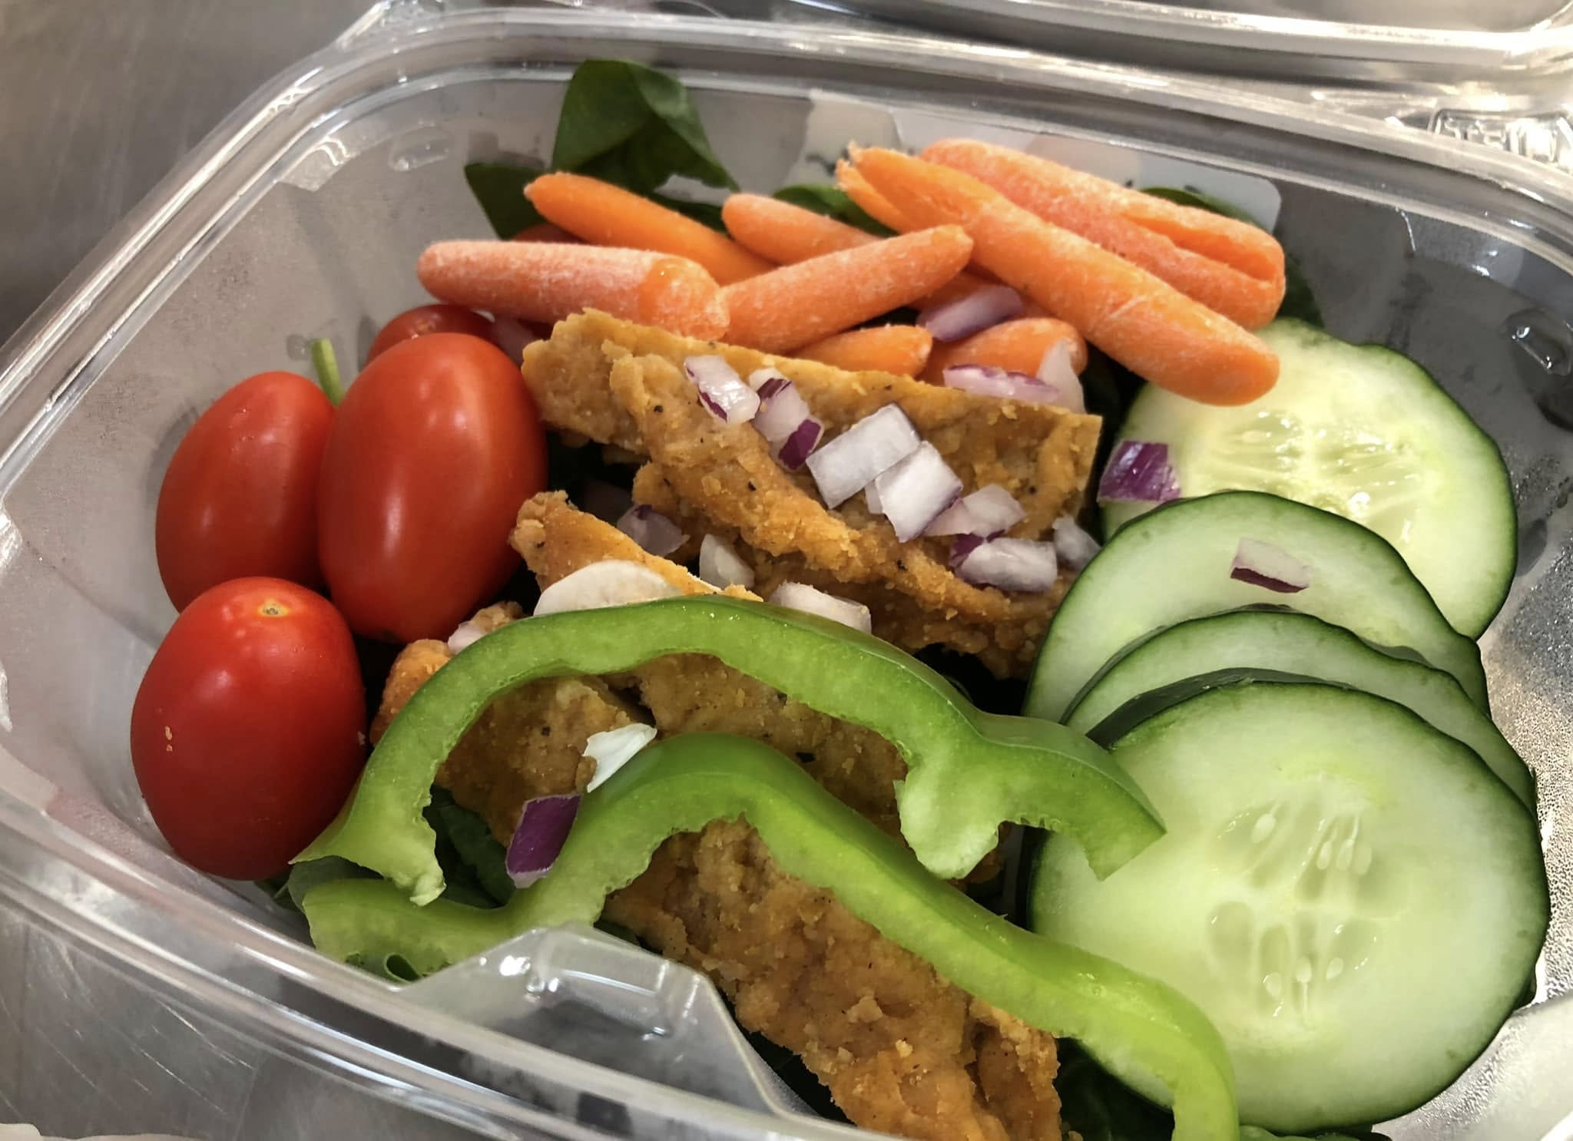
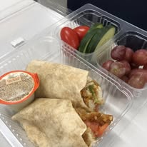
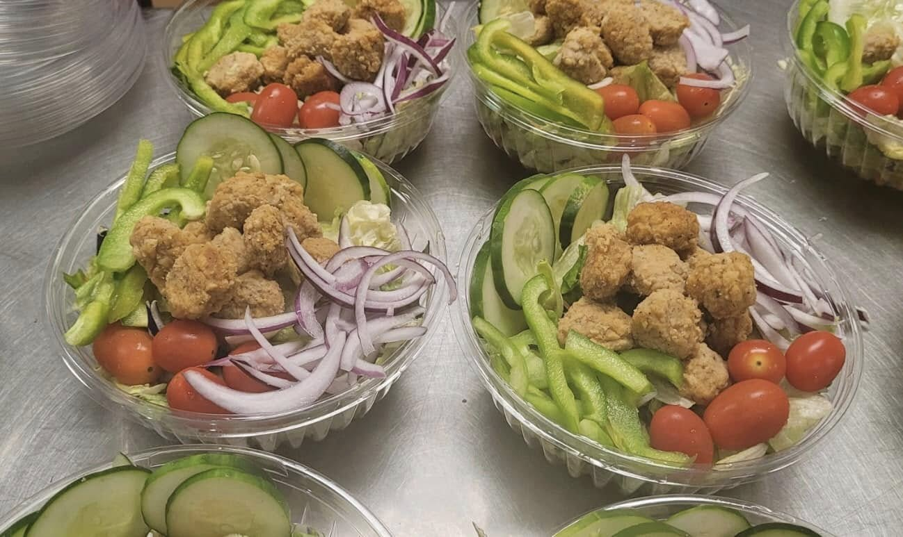
Angela Howell
Nutrition Services Compliance Coordinator
Suffolk Public Schools
#SPSCreatesAchievers
Suffolk Public Schools

Slide 3
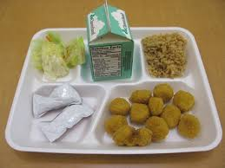
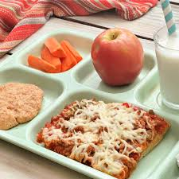
Why photographs are important
Combat stereotypes Update perceptions
#SPSCreatesAchievers
Suffolk Public Schools

Slide 4
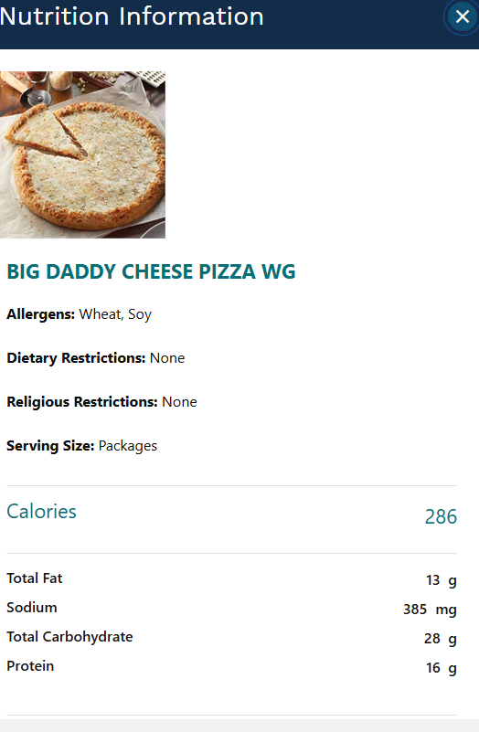
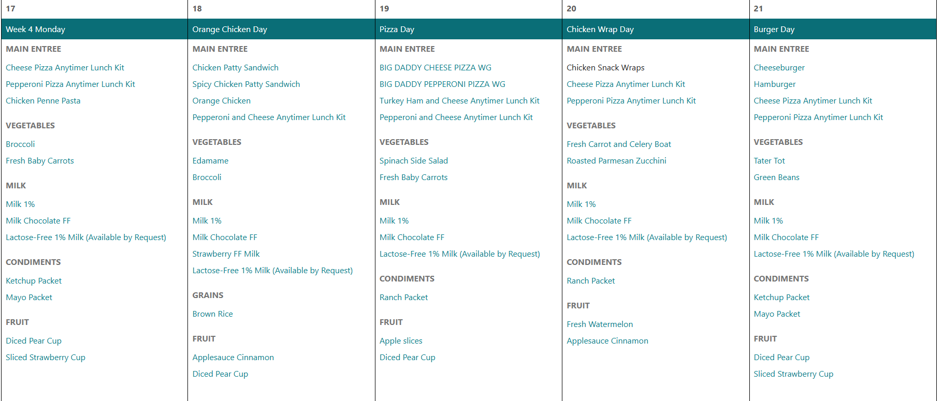
Where to us photos: Menu
What’s more compelling?
Suffolk Public Schools

Slide 5
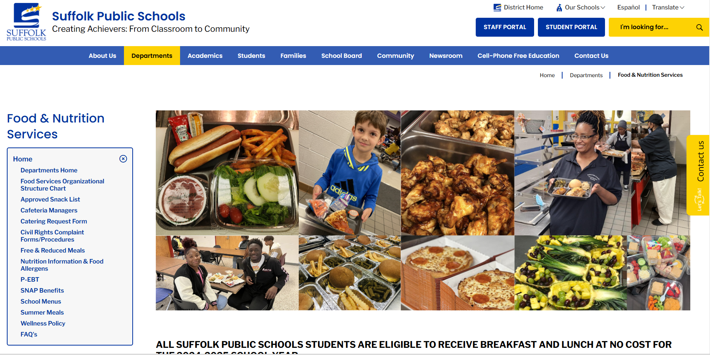
Where to use Photos:
#SPSCreatesAchievers
Suffolk Public Schools

Slide 6
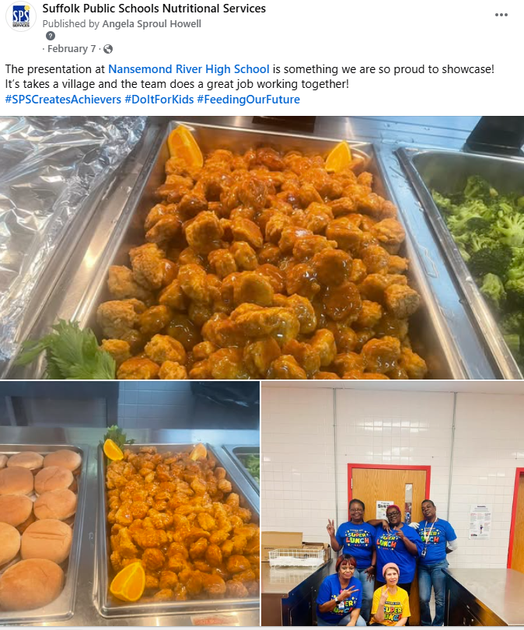
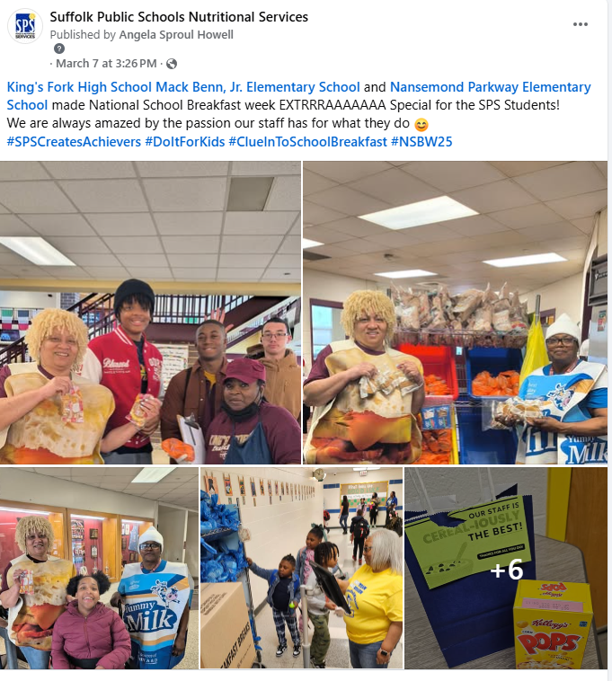
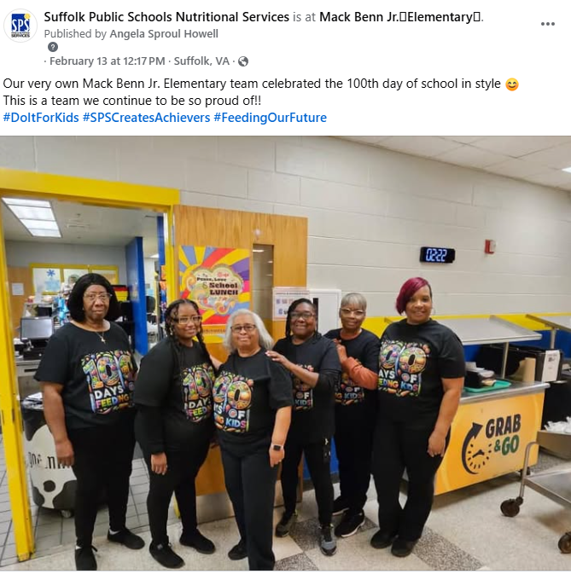
Where to use photos:
Facebook, Instagram, X
Suffolk Public Schools

Slide 7
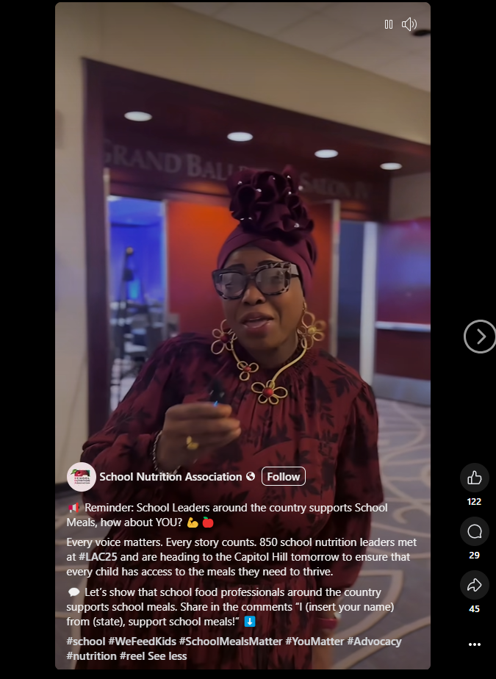
Where to use photos: Instagram Reels, TikTok
https://www.facebook.com/reel/624170923840693
Suffolk Public Schools

Slide 8
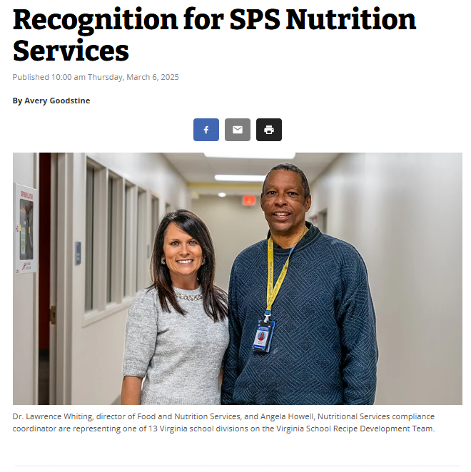
Where to use photos: Media
.
#SPSCreatesAchievers
Suffolk Public Schools

Slide 9
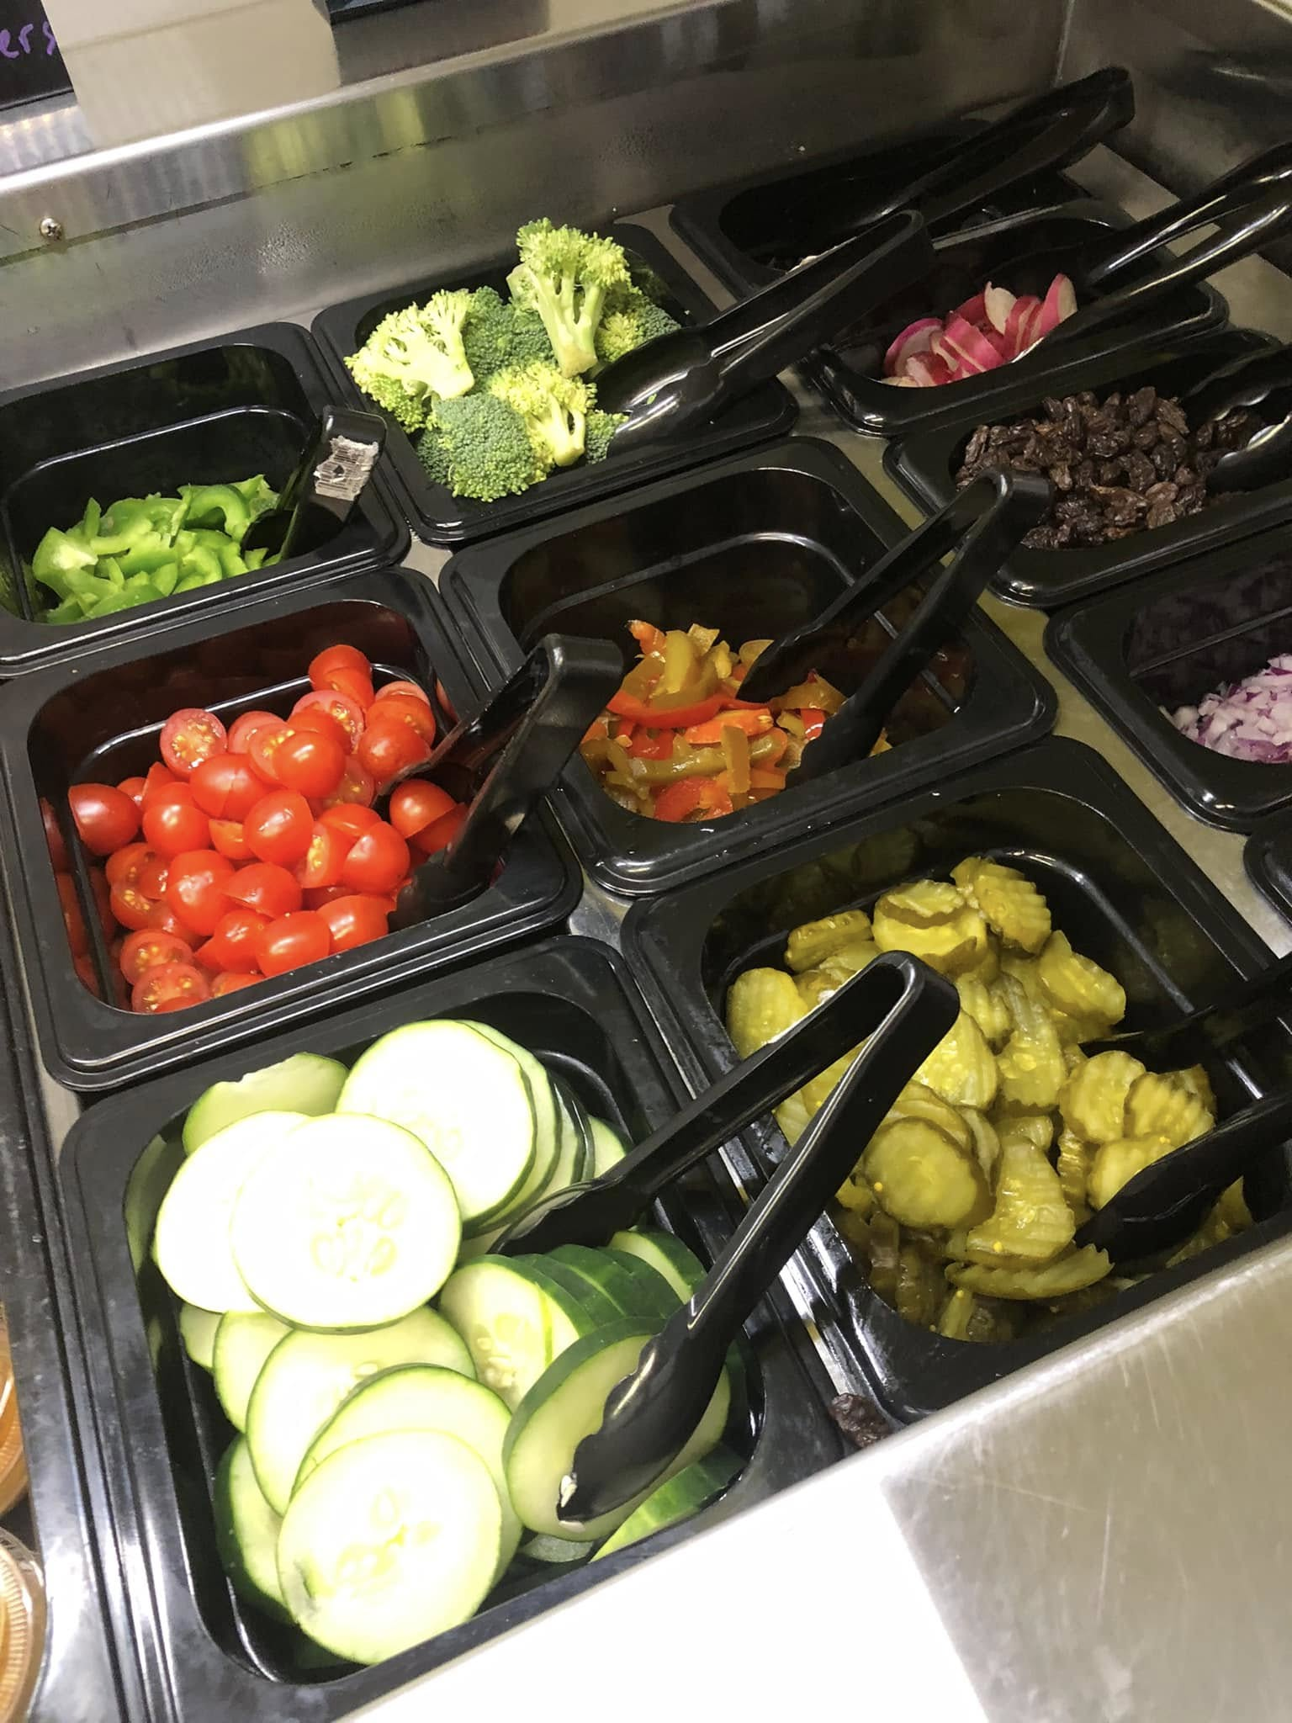
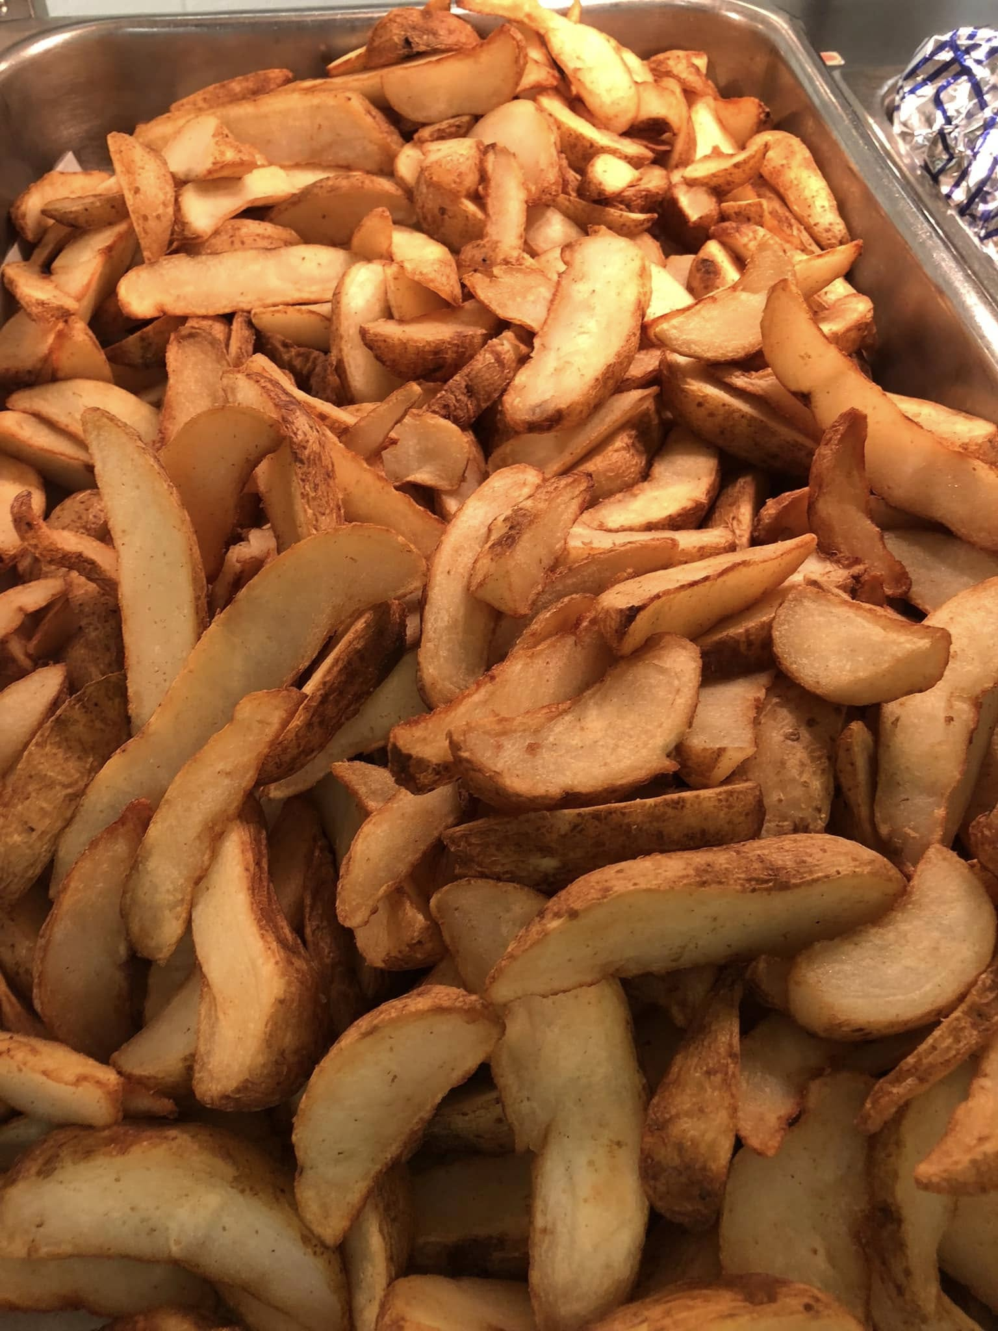
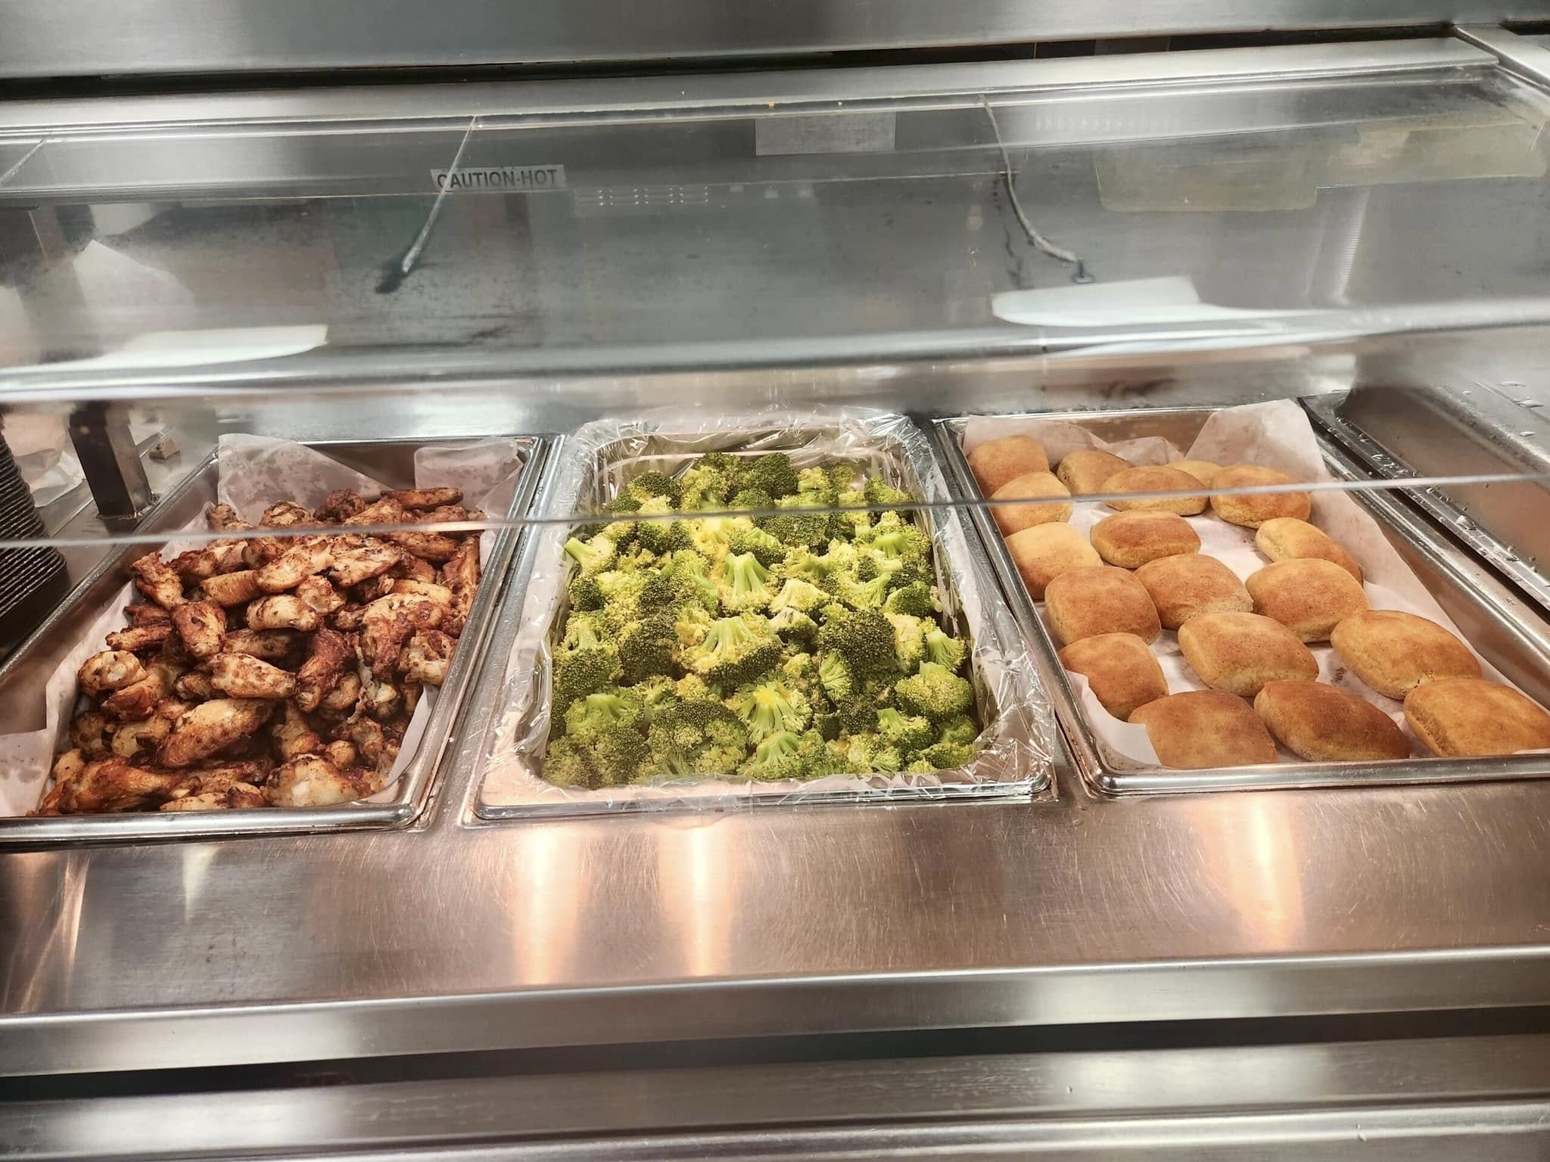
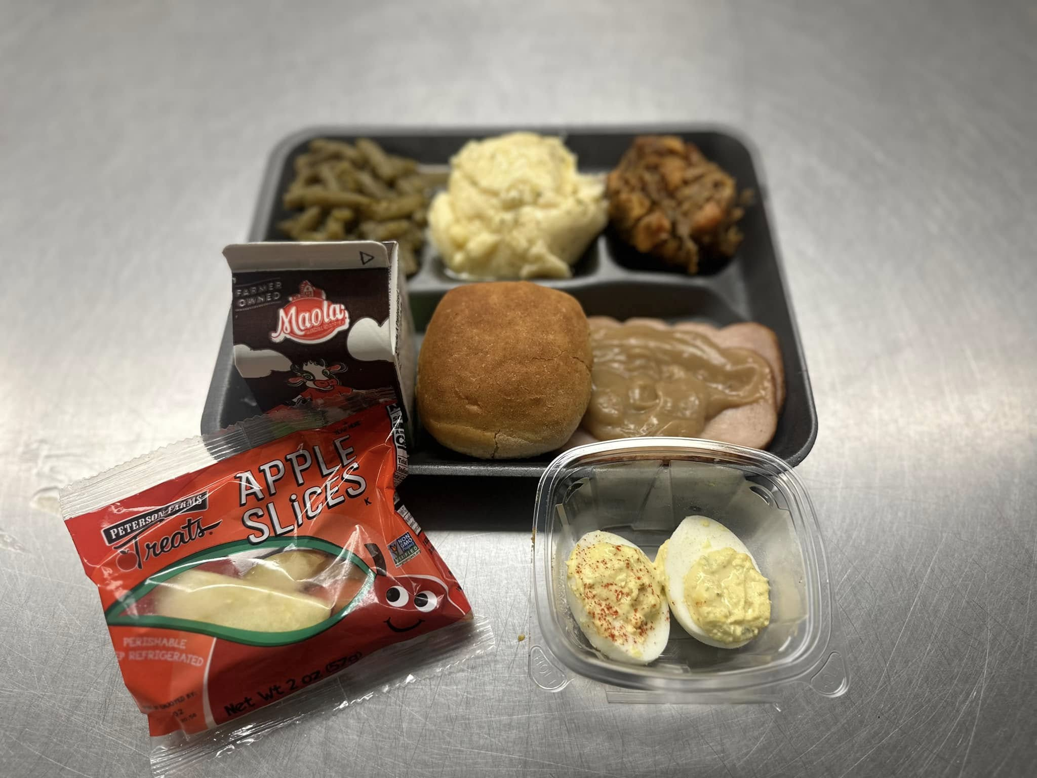
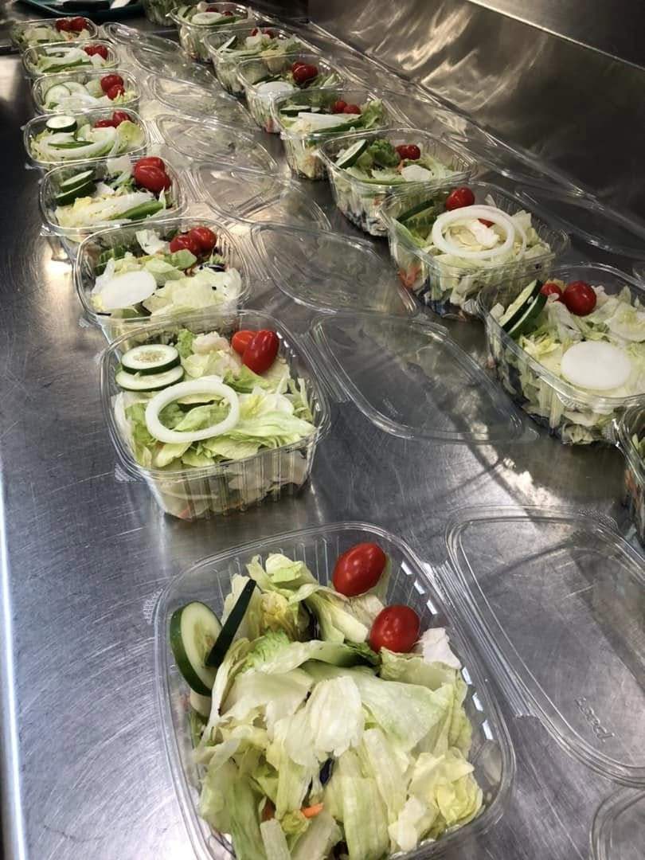
How-to: Composing photos
Add Color/Take from Different Angles
#SPSCreatesAchievers

Slide 10
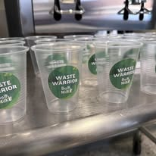
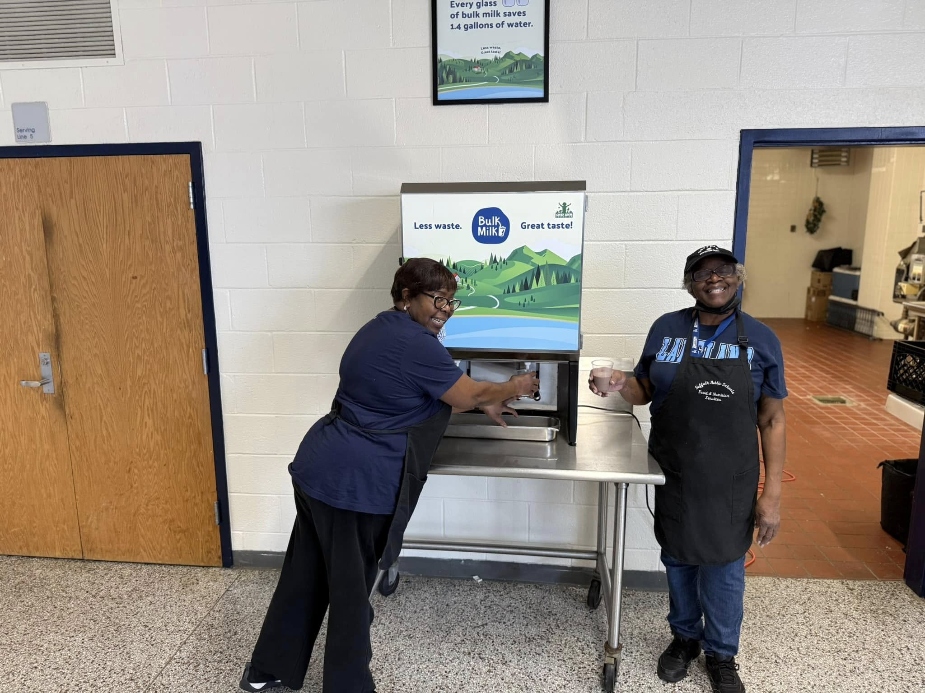
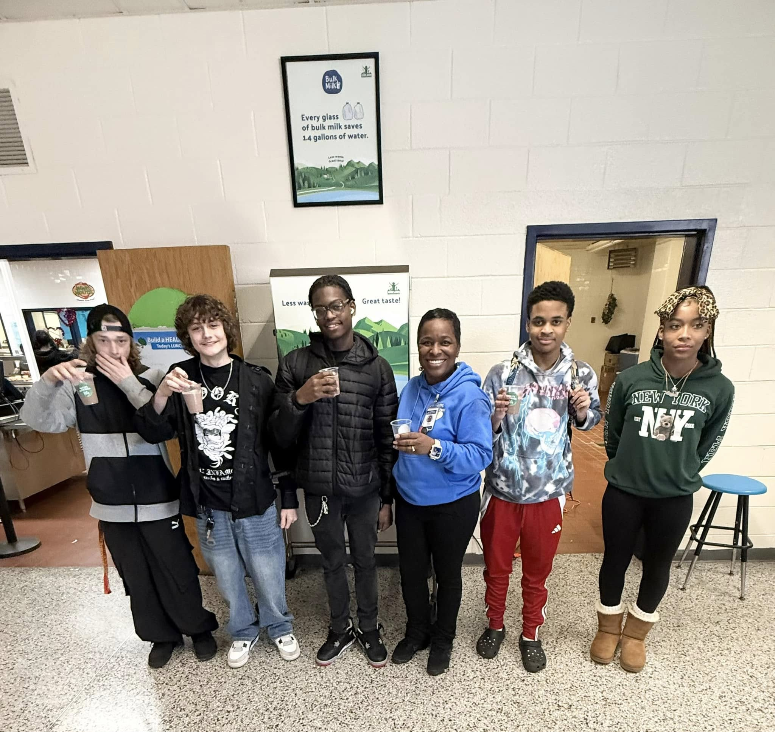
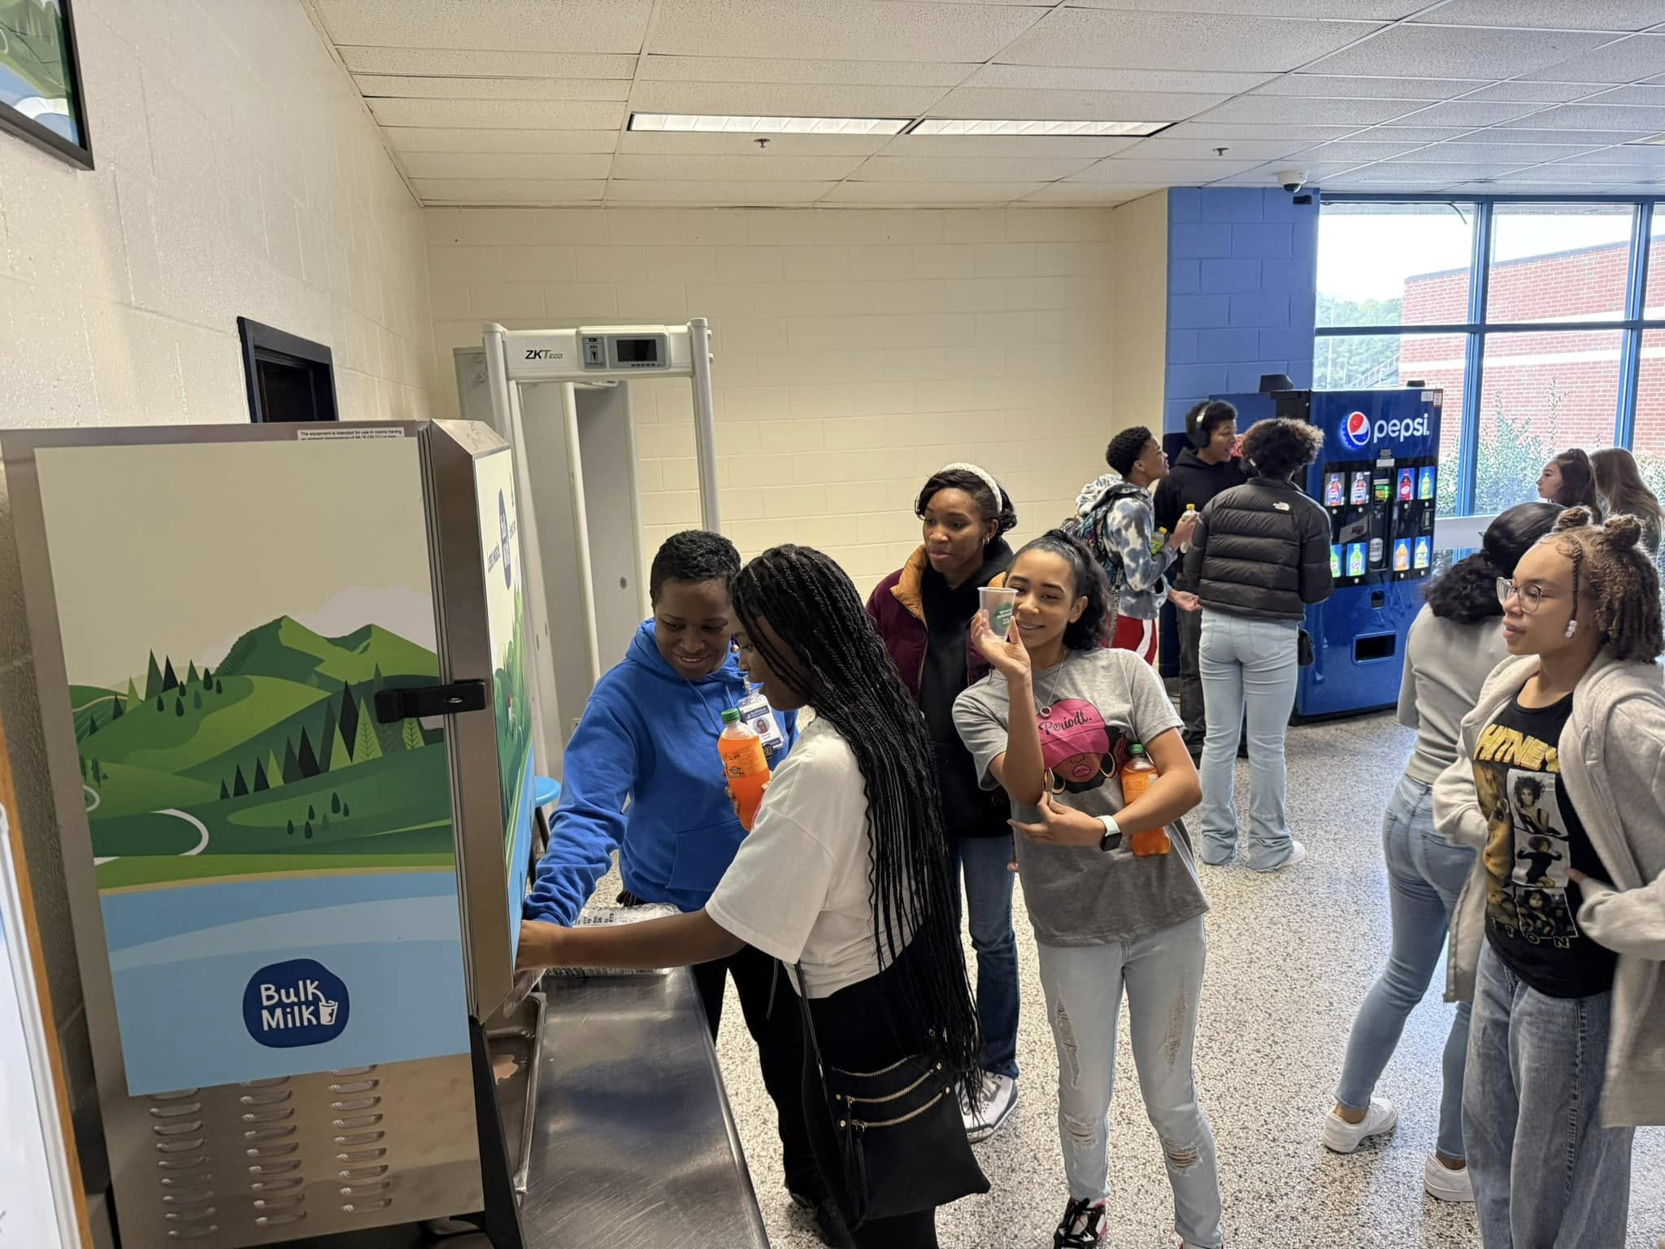
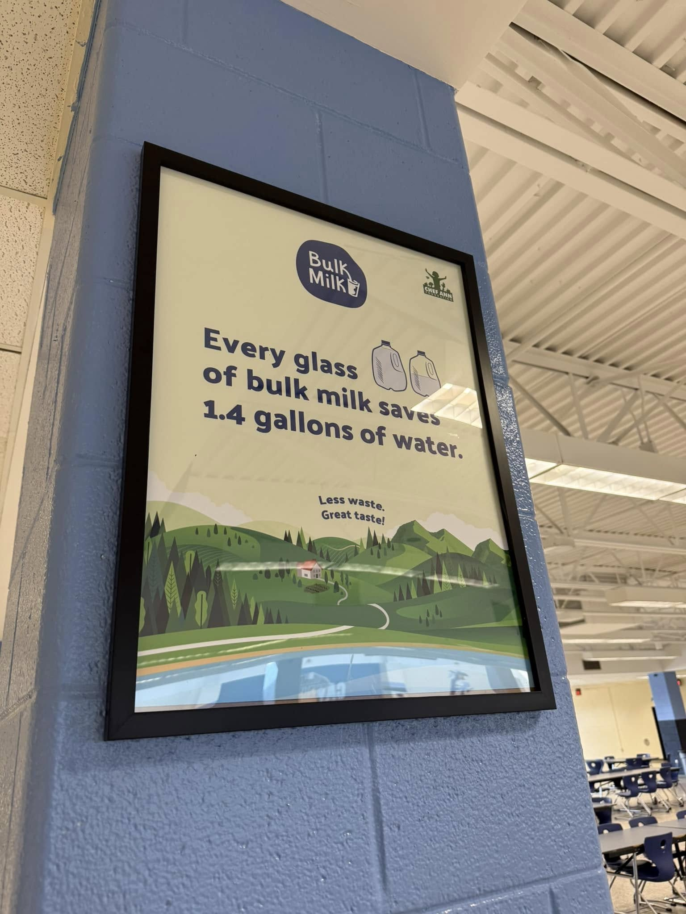
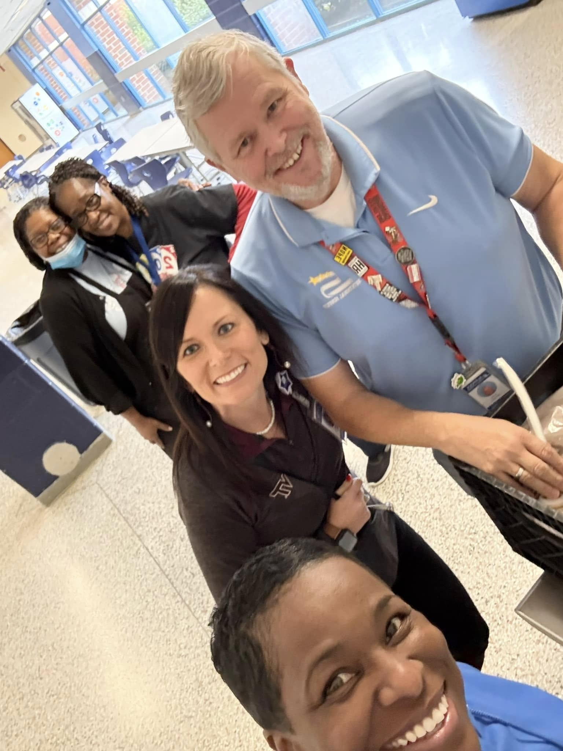
How-to: Look at it from all sides
#SPSCreatesAchievers

Slide 11
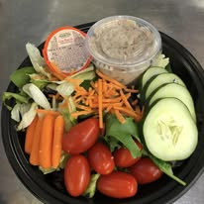
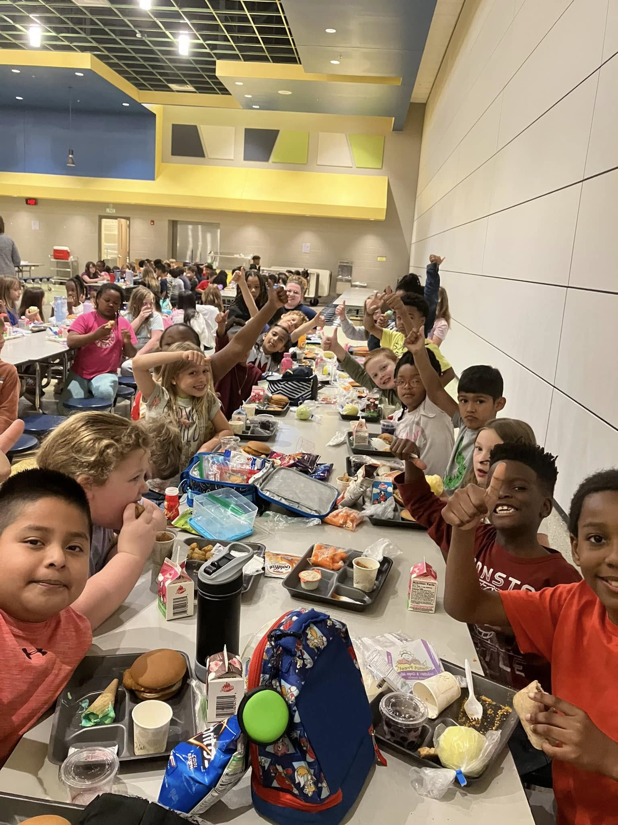
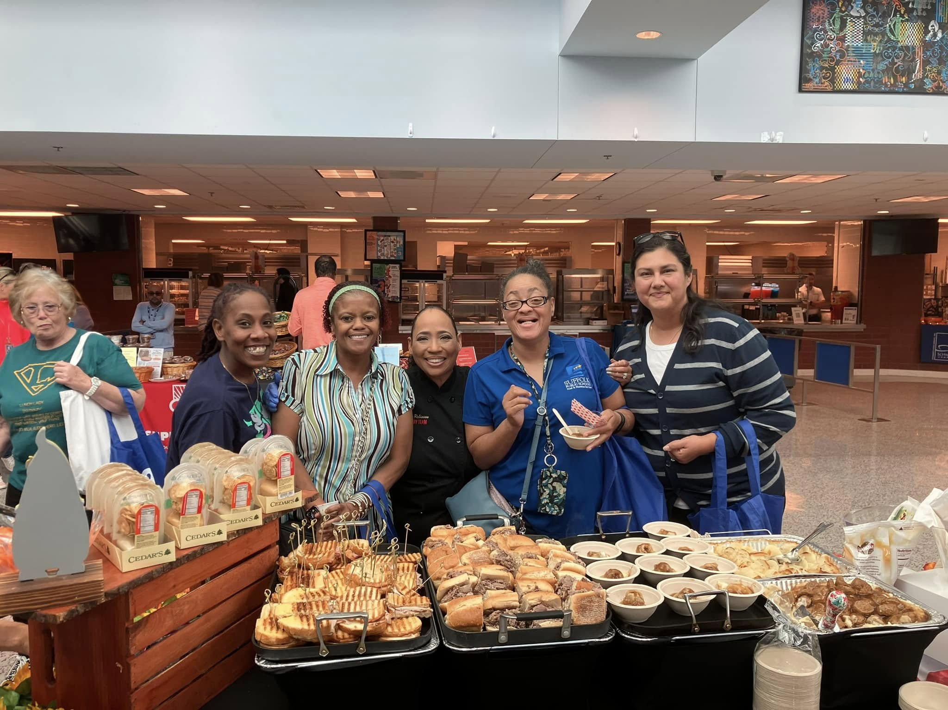
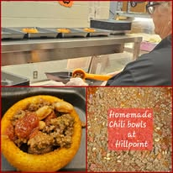
How-to: Backgrounds/Lighting
What to Take: EVERYTHING!!Meal Prep, Students in action, Local Events

Slide 12
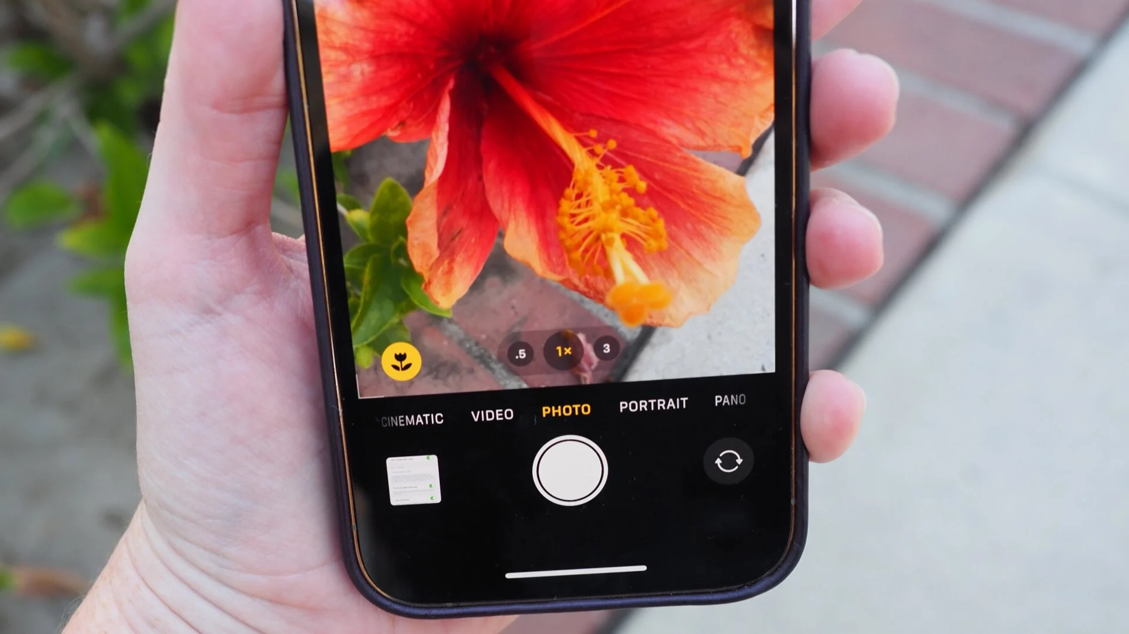
How to: Setting it up on the front end
Know your phone and familiarize yourself with the settings
Frame shot and focus
Quick iphone tutorials:
Exposure
Zoom:.5 ultra wide/1x/2
Rotating Dial
Portrait Mode!!!
Live Photos
#SPSCreatesAchievers
Suffolk Public Schools
Notes:
Used for information only slides with no photos/images.

Slide 13
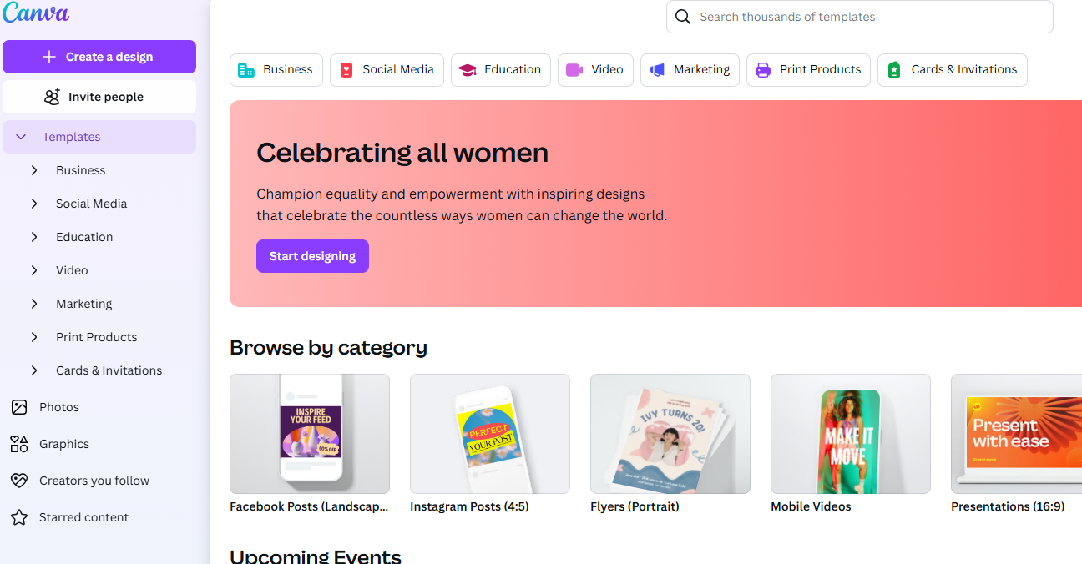
How to: Design tools
Templates based on design type, style, format
Features-Photos, icons, apps
Learning tools and tutorials
Free!!
https://gamma.app/create/generate

Slide 14
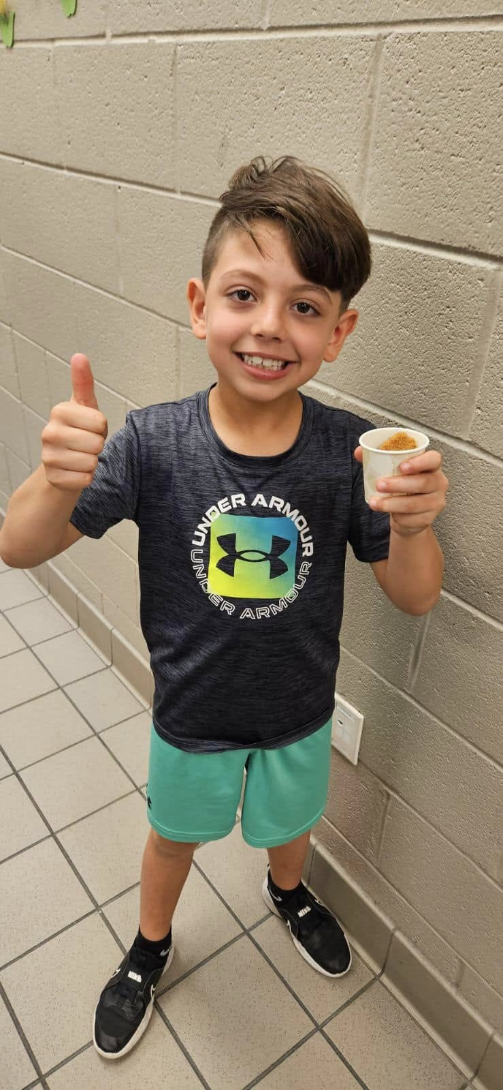
Final Thoughts/Questions
Photos change perception in a way words cannot
Start Small, get comfortable with ways to use photos
Ask for help, make it a team effort
Know your strengths and challenges
Have fun with it!
Follow up Questions
Angela Howell, angelahowell@spsk12.net
#SPSCreatesAchievers
Suffolk Public Schools
Notes:
Optional image

