Slide 1
























Feeding
Smarter, Not
Harder
AI’s Role in School Nutrition
Casey Dickinson, SNS
Notes:
The question is no longer whether you adopt AI — it’s how smartly you integrate it into your business processes.

Slide 2



What is
Artificial Intelligence?
Artificial Intelligence (AI) is a general term referring to the discipline of creating machines or programs that use data to solve programs or make decisions like humans.

Slide 3



Artificial Intelligence
RESISTENCE
Resisting change is a natural instinct, but change is the only way to grow.
AI will replace jobs
AI is too complicated
AI is expensive
AI is not safe
Notes:
But such enthusiasm is not universal. A full third of workers surveyed expressed they would like to see AI banned from the workplace. Meanwhile, 52% of workers are worried about being left behind by new technologies.
Replace Jobs:
First and foremost, this will take mindset shift. AI can enhance you, not replace you. Rather than seeing AI as a threat, recognize that it's a powerful ally in making faster, smarter decisions. AI processes data and patterns, but doesn't have human intuition, emotions, or true understanding. It works on algorithms, not reasoning.
Too Complicated: While technology, especially new technology can seem intimidating, many AI tools are design to be user-friendly and require little to no technical expertise. Some tools that you're already using that you may not have known are AI are: Autocorrect and predictive text when your, Siri and Alexa, steaming platforms (such as Netflix) recommending shows you might like to watch next. AI isn't just for tech experts, it's already woven into our daily lives in ways that make things easier, faster, and more personalized.
Expensive: Sure, some platforms require membership, but most are free for base platforms and are reasonably priced if you do opt for a premium account. Everything I will show you today, I do not pay a cent for.
Not safe: AI does raise privacy concerns, but with responsible use and proper safeguards, you can ensure data protection.

Slide 4



Should
Why I use AI?
There is simply not enough time, coffee, or you in a day.
Thought Partner
Analyzes data for data-driven decision making and strategic planning
Notes:
We all know the balancing act of managing school nutrition programs: juggling tight regulations, complex reporting, menu planning, and staffing—it’s a lot! These tasks eat up our time, leaving us less energy for the mission at the heart of it all: ensuring kids are well-fed and ready to learn. This is where AI can make a difference.
1. Efficiency and time-saving: Automates repetive tasks, steamlines things that shouldn't be taking up so much of your time
2. Thought Partner: Encourages innovation and a different way of doing things.
3. Analyzes data for data-driven decision making and strategic planning
Research shows that AI tools like ChatGPT facilitate faster, better teamwork — 12.2% more tasks completed; 25.1% faster task completion; and 40% higher quality work.

Slide 5






Ways I can AI?
Use
Repetitive & Admin Tasks
  Emails, Docs (proof read)
  Disciplinary
  Meeting Minutes
  Drafting SOPS
Team Building, Employee Wellness
FUN!
Therapy
Strategic
Planning & Data Analysis
Leadership Development, Training Planning, Development, & Execution
Menu Planning
  Full menus
  Theme Menu
  Incorporating F2S

Slide 6
Now, let’s look at AI in
ACTION!

Slide 7
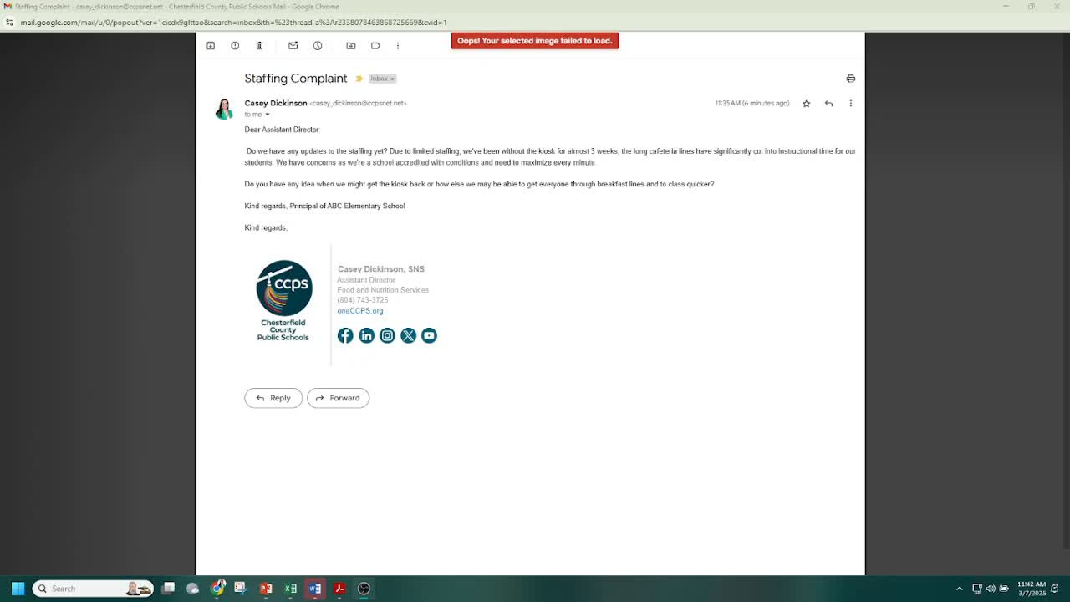
ChatGPT
(Gemini)

Slide 8
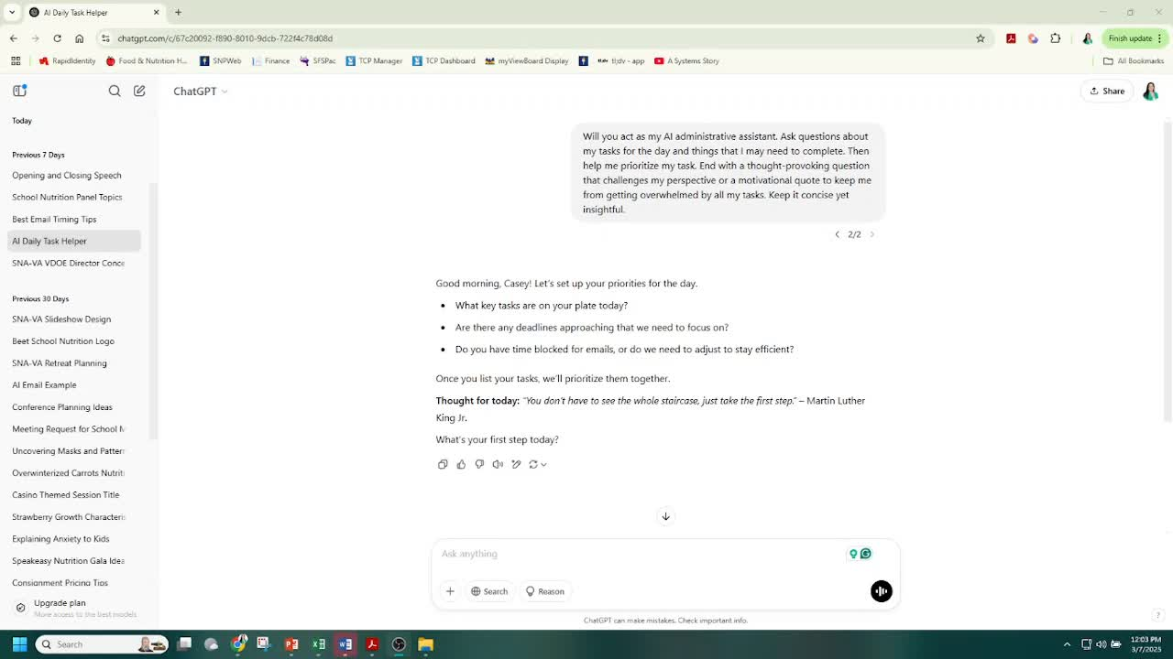
ChatGPT
(Gemini)

Slide 9
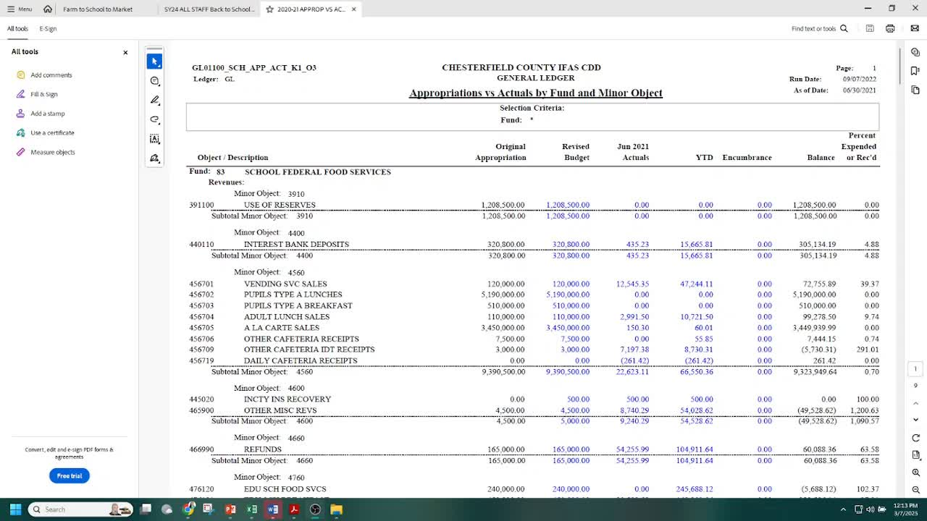
ChatGPT
(Gemini)

Slide 10
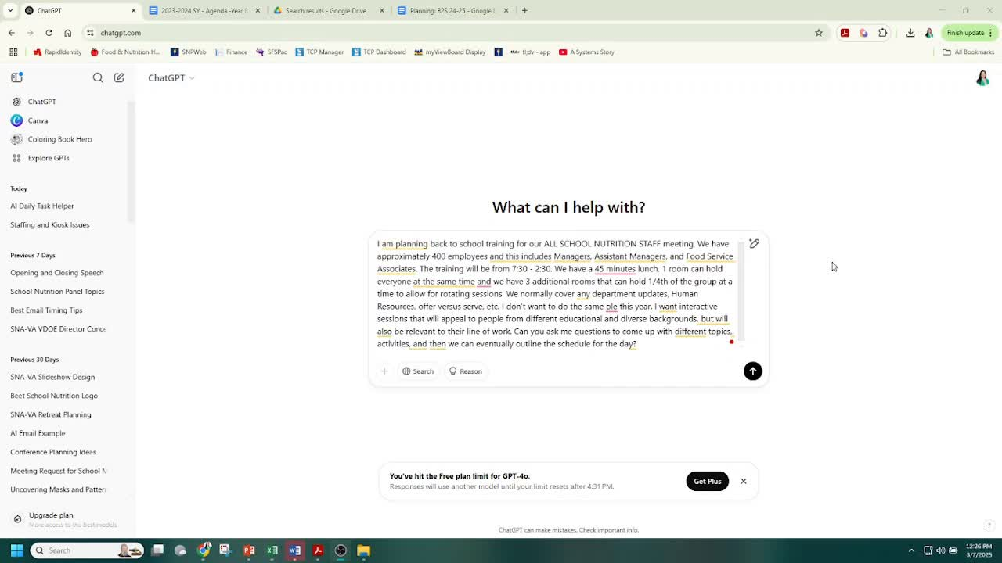
ChatGPT
(Gemini)
Notes:
After: Due to timing, I can't show you all of the capabilities of ChatGPT, but I hope you get the gist of all the things you can use ChatGPT to bounce ideas off of. And how you can question or have it elaborate in certain areas.

Slide 11
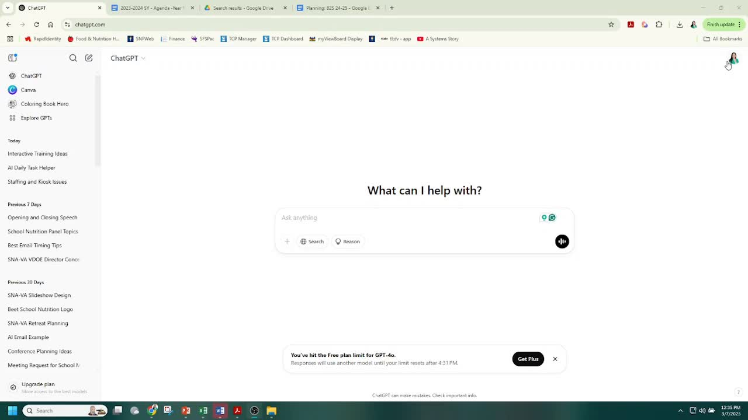
ChatGPT
(Gemini)

Slide 12
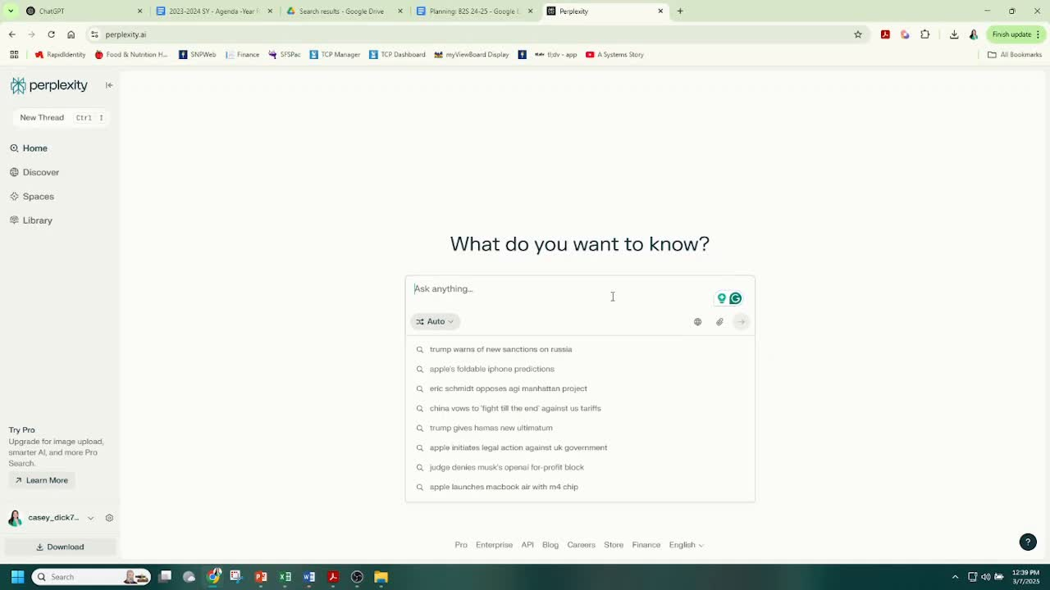
Perplexity

Slide 13
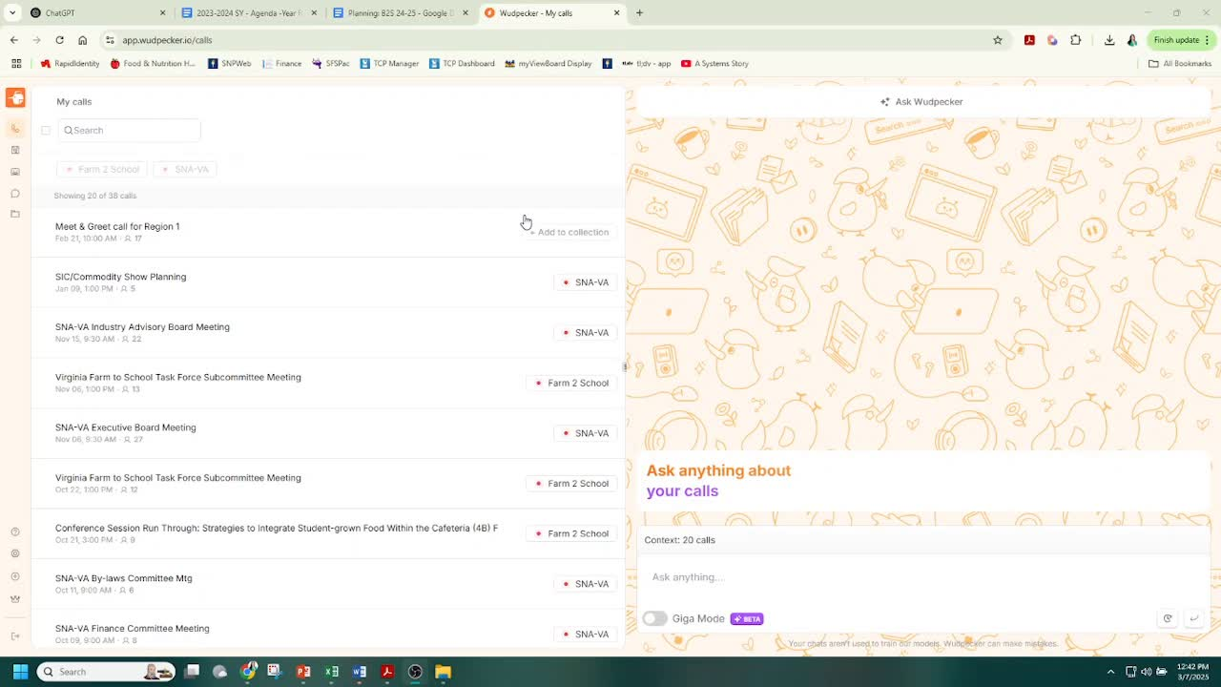
Wudpecker.io
(OtterAI)

Slide 14

Grammarly

Slide 15

Suno AI

Slide 16

Suno AI

Slide 17
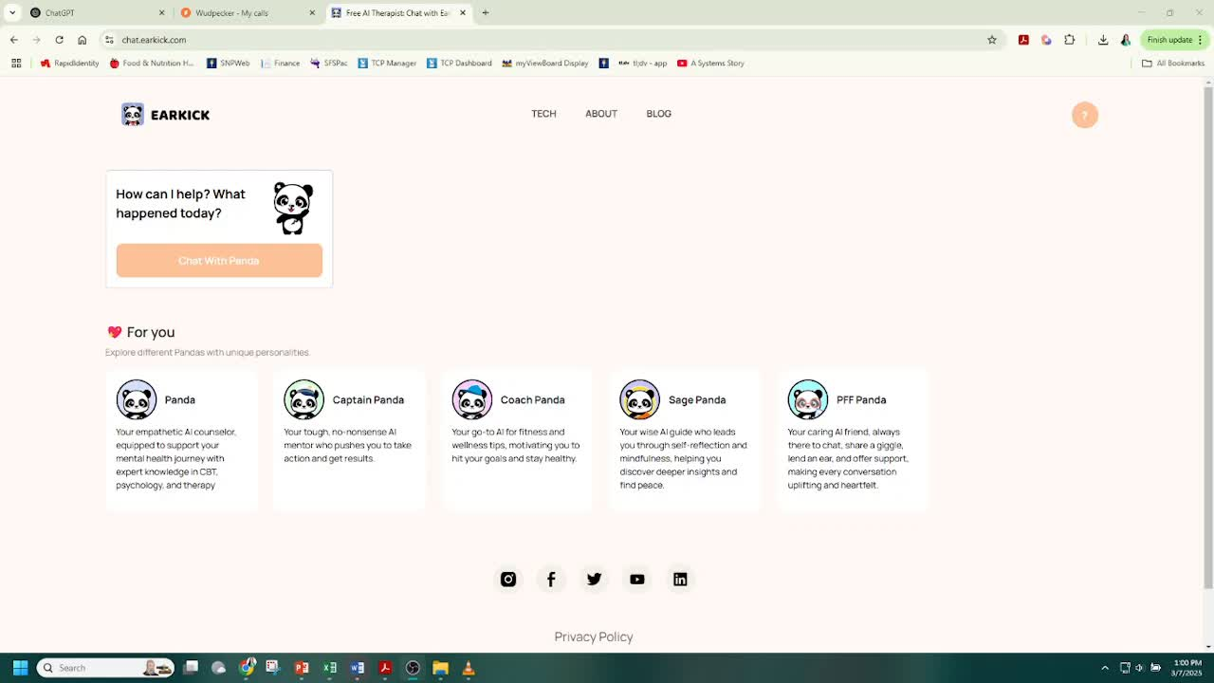
EarKick

Slide 18
Other AI
Tools
Honorable mentions
Canva
  Translation
  Magic Media
NextGen Jen
  School Nutrition focused
HeyGen
  Avatars
  Translation
  Recorded Trainings

Slide 19


Slide 20



Slide 21













Ingredients for
Strong Prompts
Specify Requirements
Describe the Task
Ask it
to interview
you
Assign a Persona
Give Context
Experiment
& Refine
Notes:
The quality of your input determines the quality of your AI’s output.

Slide 22





Key
and Next Steps
Takeaways
AI saves time and reduces stress
Start small: One process at a time.
Explore different AI tools, sign up for AI newsletters

Slide 23
THANK YOU!
Any questions?

