Slide 1



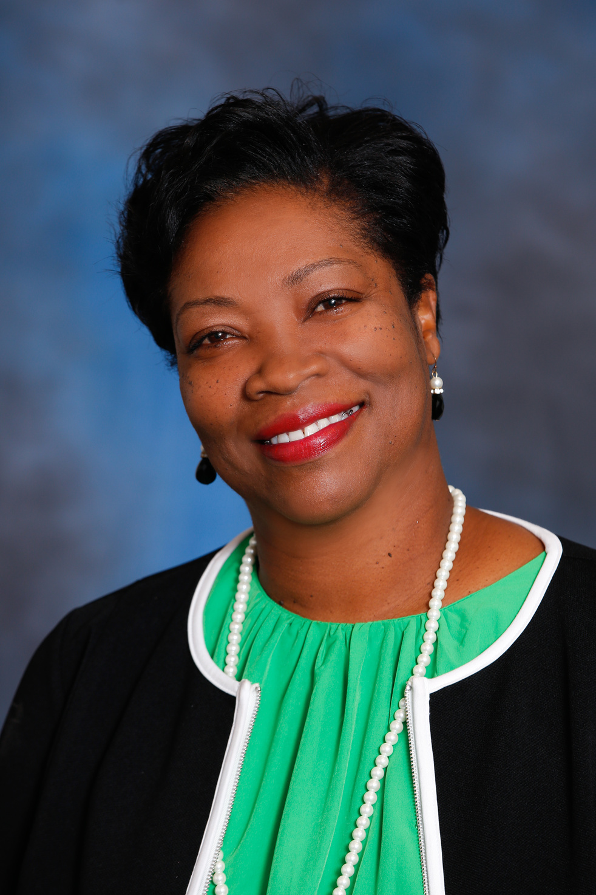

Keynote Speaker Vanessa Hayes
Notes:
Beth Morris
Our keynote speaker is a chef, a mother, and a passionate school nutrition professional. She holds an Associate’s degree in Culinary Arts from the Art Institute of Atlanta and trained under French Chef Alain Bedard. She later earned a Bachelor’s in Business Administration from Tuskegee University and a Master’s in Public Administration from Valdosta State University. She also obtained her School Nutrition Certification from the University of Georgia and SNS credentialing from the School Nutrition Association. Vanessa’s career spans roles as a Private Chef for high-profile clients before transitioning to school nutrition. She has held multiple leadership positions in the Georgia School Nutrition Association and with SNA National. Please welcome Vanessa Hayes to the stage!

Slide 2


Slide 3


GRIT
GRIND
GRATITUDE…The Sparkle That Makes School Nutrition Shine!
Vanessa Hayes
Inspirational Speaker, Life Coach, and Chef

Slide 4
The 3 G’s of Life
Grit
Grind
Gratitude

Slide 5
Grit
Grit is passion and perseverance for long-term and meaningful goals.
It is the ability to persist in something you feel passionate about and persevere when you face obstacles.
(This kind of passion is not about intense emotions or infatuation).
It's About Having Direction and Commitment

Slide 6
Traits of Grit
Vigilant
Resilience
Passionate
Courageous

Slide 7
Grind
The difficult, routine, or repeated tasks of daily work
Today, we live in a grind culture of “workplace hustle” and “go big, and don't go home” mentality.
(This does not mean only when it benefits you as an individual)
The Art of Consistent Hard Work

Slide 8
Effective ways to Grind
Push yourself
Stay committed
Be Consistent
Find the good
Never give up

Slide 9
Gratitude
Gratitude is a positive emotion that involves being thankful and appreciative and is associated with several mental and physical health benefits
The quality of being thankful; readiness to show appreciation for and to return kindness
Gratitude helps people feel more positive emotions, relish good experiences, improve their health, deal with adversity, and build strong relationships.

Slide 10
Elements of Gratitude
Awareness
Compassion
Deep Appreciation
Selflessness
Loss of Entitlement

Slide 11
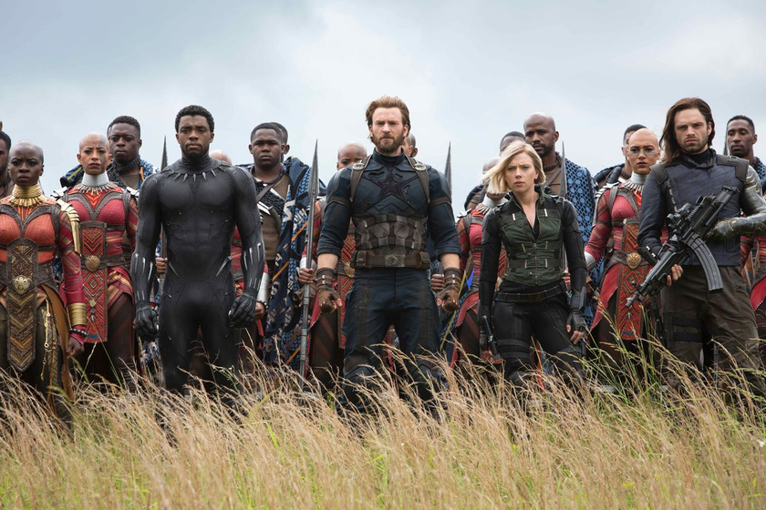
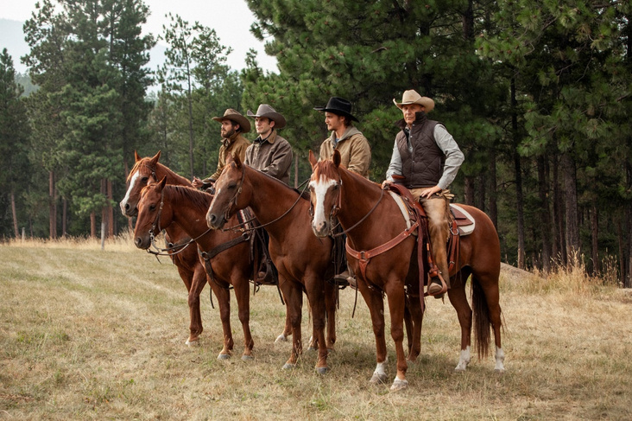
The 3 G’s are Essential to Success
Lead from the Front
Dare to be Different

Slide 12
Remember that all great People…
Know How to Operate With Grit…
Know How to Grind Daily…
Know How to Be Intentional…
Know How to Show Gratitude…

Slide 13
Chef by Trade
Motivated by Love
Gifted By God

