Slide 1
Driving Success: Mastering Program Management with Key Performance Indicators
Beth Mills, MS, RDN, SNS
Notes:
Scroll to the end to find supplemental slides including Strategic Plan icons to add to every slide in your presentation.

Slide 2
Acknowledgements & Inspiring Leadership Quotes: Capturing the Journey
Teamwork Makes the Dreamwork
Every adversity, every failure, every heartache carries with it the seed of an equal or greater benefit. We don't develop courage by being happy every day. We develop it by surviving difficult times and challenging adversity.

Slide 3
Old Style Cost Control
Controlling Primary Program Expenditures: Food and Labor
 | Cost as a Percentage of Revenue (CPofR) | Meals per Labor Hour (MpLH)
Labor | X | X
Food | X

Slide 4
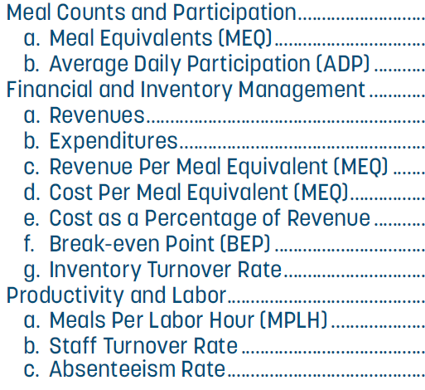
Key Performance Indicators
Essential to the Effective Management of the SNP

Slide 5
Accessing Cost of Goods Sold Data
Requires a New Process for Transacting Sales
 | Traditional Meal Sales | Meal Combining
Transaction Key Stokes | 1 per reimbursable meal | 3+ per reimbursable meal
Transaction Time | 2 seconds | 5 – 15 seconds
Reimbursable Meal ID | Cashier | Software
Configuration Set Up Time | Minimal | Extensive

Slide 6
Meal Combining Configuration
Required Changes in 4 Titan Modules: Menu Planning, Order Inventory, Point of Sale
Configuration of Recipes and Inventory Items
Assignment of Prices and Color Codes for Titan Point of Sale Screen (POS)
Creating and Configuring POS Pages
Configuring Device Layouts by School Level and Serving Sessions
Configuring for Meal Combining Pricing
Assignment of Serving Sessions
Confirming Accuracy of Inventory Crediting
Testing and Deployment

Slide 7
Cost of Goods Configuration
Required Changes in the Accounting Module and the General Ledger
Ensured all General Ledger data was accurately reflected in the KPIs.
Acted as a data validator for reports including General Ledger data.
Supported the validation of enrollment and payroll data.
Used Excel formulas and pivot tables to verify data accuracy.
Started data verification with small samples, progressing to larger ones.
Tested reports in various Oracle environments until all reports went live.

Slide 8
KPI Reports Require Data Scheduling & Coding from Multiple Sources before Automation
Oracle EBS & Titan Software
Close the Accounts Module
Process Reports

Slide 9
Improved Decision-Making; Enhanced Transparency and Accountability
by Cost Center, by Level, and by District
Better Decision Making
Enhance Transparency and Accountability

Slide 10
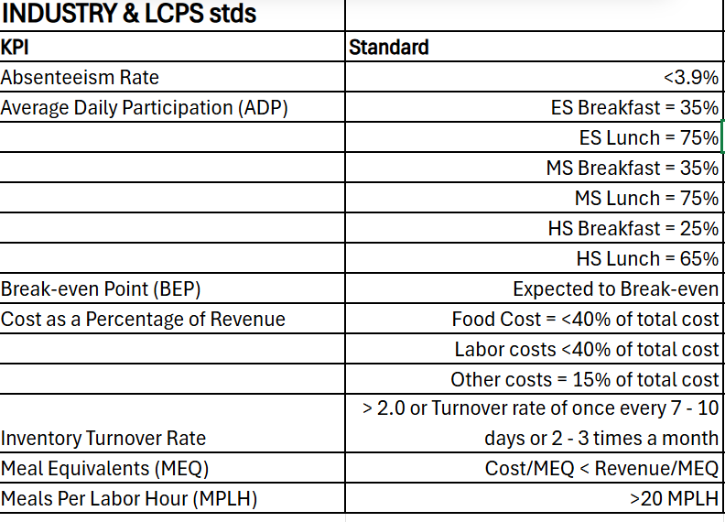
Goal Directed Financial and Operational Performance
Industry & LCPS Standards

Slide 11
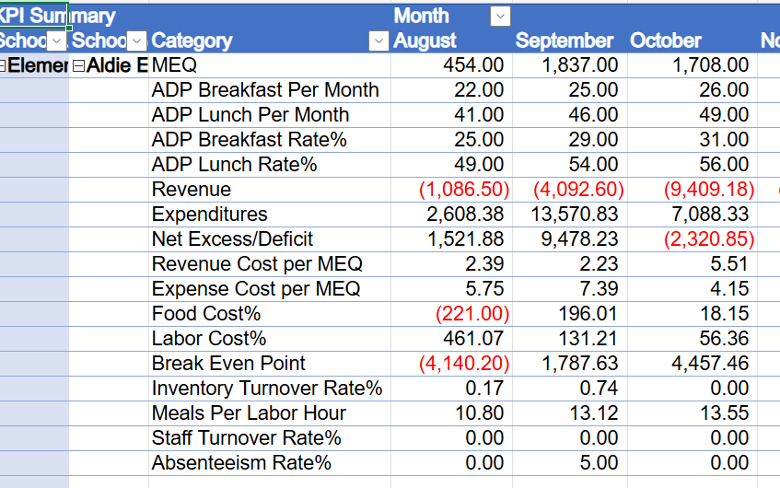
Summary Report

Slide 12
Absenteeism & Staff Turnover Rate Report
OCTOBER | Absenteeism Rate % | Staff Turnover Rate %
Elementary Schools | 5.3% | 0.6%
Middle Schools | 7.0% | 0.0%
High Schools | 6.4% | 0.0%
District Wide | 6.0% | 0.6%

Slide 13
Meals per Labor Hour
Meals per Labor Hour
 | August | September | October | November | December | January | February
Elementary | 19.74 | 23.55 | 24.90 | 25.64 | 25.36 | 25.11
Middle | 20.95 | 24.36 | 25.15 | 25.24 | 24.86 | 24.41
High | 24.02 | 27.88 | 28.91 | 28.02 | 27.18 | 24.80

Slide 14
Inventory Turnover Rate
Inventory Turnover Rate
 | August | September | October | November | December | January | February
Elementary | 0.70 | 1.49 | 1.26 | 1.06 | 1.19 | 0.81
Middle | 0.62 | 1.76 | 1.61 | 1.38 | 1.49 | 0.99
High | 0.74 | 1.77 | 1.77 | 1.48 | 1.64 | 1.08

Slide 15
Unresolved Challenges

Slide 16
Thank you for allowing LCPS to present on KPI reporting and automation. We appreciate the opportunity to share our insights and experiences with you.
If you are interested in learning more about automating KPIs, LCPS will organize a meeting for all interested parties to provide guidance and share lessons learned.

