Slide 1
Welcome SNA VA First Timers!
2025 SNA-VA State Conference & Exhibit Show

Slide 2
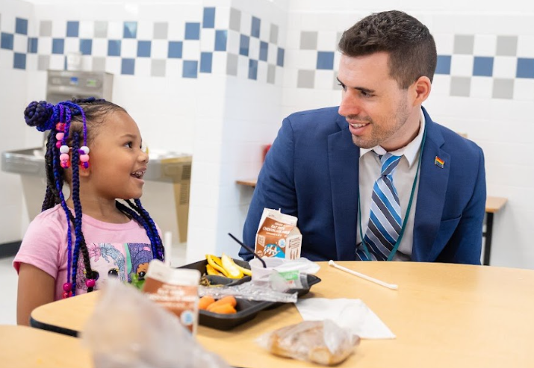
Shaun Sawko MS, RD/N
Executive Director, Food and Nutrition Services
Fairfax County Public Schools

Slide 3
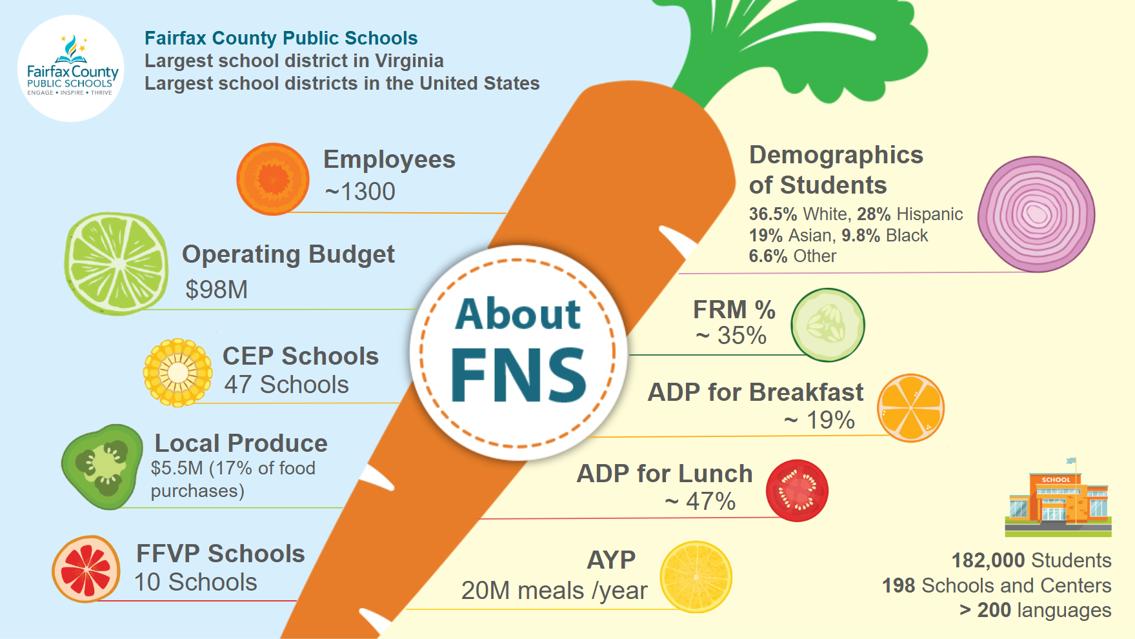

Slide 4
Acknowledgement of WHO is in the room
Food Service Workers
Food Service Manager
Food Service Chefs
Menu Planners
Supervisors
VDOE State Agency Representatives
Industry Representatives
Directors

Slide 5
Activity
Networking Challenge
- Find someone who...
- Works in a different school district than you.
or
- Works in a similar role as you and exchange one challenge + solution.

Slide 6
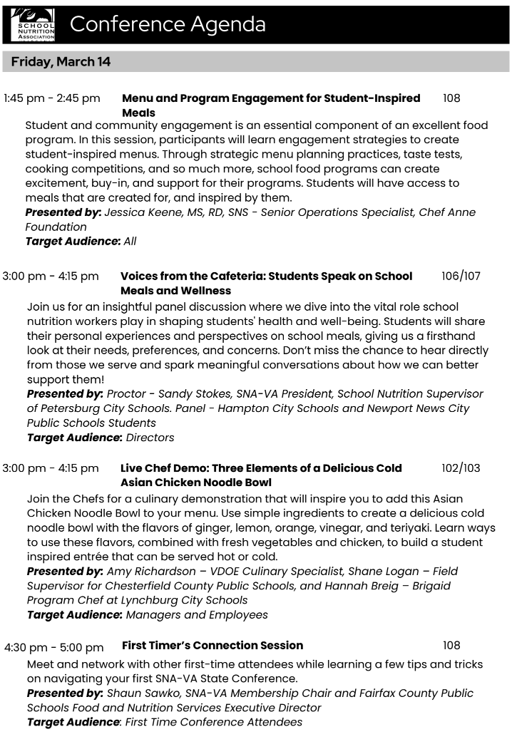
Conference Agenda
Your KEY to knowing where to go and what to LEARN

Slide 7
Navigating the Agenda
Education Sessions
General Sessions
Food Show & Exhibits
Networking opportunities
Twilight Extravaganza
Awards Banquet

Slide 8
Navigating the Agenda
Target Audience:
All
Employees
Managers
Supervisors
Directors
Presented by:
What is their position
What is their school division/organization?
Is it a similar size/model as yours?

Slide 9
Making the most of Networking
Tips on meeting peers, industry leaders, and vendors
How to approach networking even if you’re an introvert
Encouraging connections beyond the conference
LinkedIn, Local Chapters

Slide 10
Exploring the Exhibit Hall
How to engage with vendors and sample new products
Best practices for gathering resources without being overwhelmed
What to look for when visiting booths
New trends
Solutions for your operations

Slide 11
Professional Development & Growth
How to apply what you learn to your role
Opportunities for leadership programs and future involvement in SNA VA

Slide 12
Conference Checklist
✅ Pre-Conference Prep
☐ Review the conference schedule and mark must-attend sessions. ☐ Bring business cards (or prepare a digital contact-sharing method). ☐ Set a personal goal: What do you want to learn or accomplish?
📍 Conference Must-Dos
☐ Introduce yourself to at least 3 new people. ☐ Visit at least 5 exhibitor booths and ask, “How can this help my school nutrition program?” ☐ Attend a breakout session and write down two key takeaways. ☐ Ask a speaker or panelist a question. ☐ Take a photo with a new colleague and share one key learning.
🤝 Networking Challenge
🎯 Find someone who… ☐ Works in a different school district than you. ☐ Has attended this conference before and ask for their best tip. ☐ Works in a similar role as you and exchange one challenge + solution. ☐ Is presenting at a session and ask what inspired them to share.
🚀 After the Conference: Take Action
☐ Follow up with at least 3 people you met (LinkedIn, email, or phone). ☐ Share 3 key takeaways with your team back at work. ☐ Identify one new idea to implement in your program. ☐ Consider joining a committee or getting more involved with VSNA.
BONUS: If you complete this checklist, find me and share your experience! I'd love to hear how your first conference went.

Slide 13
Q&A and Closing
Questions or Thoughts?
Sharing your plan?

