Slide 2
The Self-Aware Leader

Slide 3
About the Presenter
Dr. Eric Coleman
M.Ed, MBA, M.Psych, CSC
Director, Office of School Nutrition Services
Alexandria City Public Schools
Alexandria, VA

Slide 4
Affiliations & Disclosures
Dr. Eric Coleman– Founder and CEO, DCRConsulting, LLC
Author: Paradigm “Thinking Different about Relationships”

Slide 5
District
Profile
Alexandria City Public Schools
Alexandria, Virginia
District Size: 16,303
Number of Schools: 18
Number of Students Served: approx15,000 a day
Free and reduced Percentage: 47%
Budget: 13 million
Team Size: 160
Meals per year: 13 million

Slide 6
Road Map
HAVE THE HARD CONVERSATION WITH YOURSELF
HOW DO YOU THINK
IDENTIFY YOUR LEVEL OF ENGAGEMENT
RELATIONSHIP BUILDING STRATEGIES
It all starts with “YOU” as the leader [its not about the other person]
Empower you to Self-Reflect and Cultivate meaningful connections and relationships

Slide 7
Meta Cognition
Thinking about Thinking
CONSTRUCTIVIST THEORY
WHEN WAS THE LAST TIME I GENUINELY TOOK AN HONEST INVENTORY OF WHAT INFLUENCES MY THINKING, DECISION MAKING, AND HOW I ENGAGE IN CONNECTIONS

Slide 8
Why is this important in the workplace?
IMPACT + INFLUENCE = LEADERSHIP

Slide 9
Replication

Slide 10
Human Nature
Physiological: Basic needs to exist
Safety: Protection from the risk of danger or to infiltrate barriers
Social: Interaction outside of self and focus redirected to others
Esteem: Self-worth and value
Self-Actualization: Potential realized. Able to influence others
Maslow, 1943

Slide 11
Self Reflection
What is Self Reflection?

Slide 12
Activity of Engagement ***Selfie Time***
Look at yourself in the mirror…
What words describe current characteristics, emotions and thoughts “baggage” you bring into relationships at work?
*Industry Partners, Clients, Superiors and Direct Reports*

Slide 13
Characteristics
Disappointment
Fear
Resentment
Anger
Distrust
Trauma
Disloyalty
Past Hurts
Unresolved Issues
Triggers
Insecure
Disengaged
Not valued
Self Preservation
Your story only matters
Lack of Emotional Intelligence
Resistance
Joy
Love
Peace
Compassion
Save the World
Empathy
Sympathy
Long Suffering
Open-Mindedness
Caring

Slide 14
Self Reflection
Does the perception you have about yourself align with reality?
Will your perception align and agree with what others say about you?

Slide 15
Acknowledge and confront influences that have shaped and guided the way you “show up in” and “approach” relationships [Share Out]

Slide 16
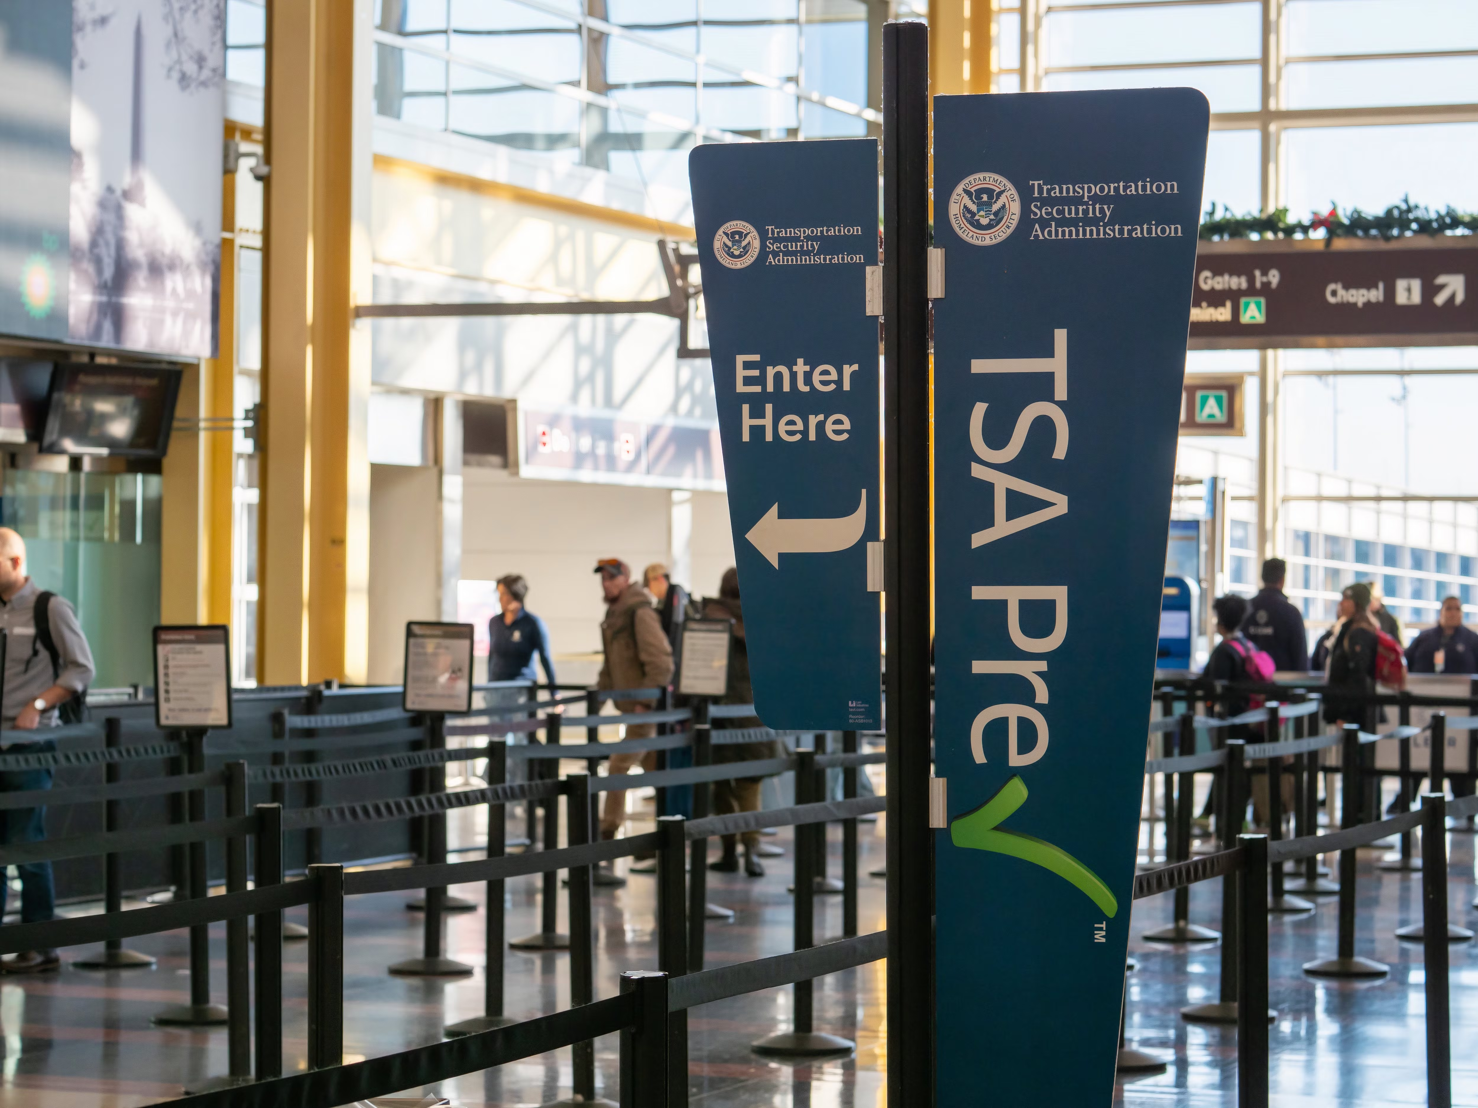
“That is just who I am”
This mindset of thinking is a complete and utter cop-out and an unwillingness to evaluate who you are; better yet its an outright abandonment of individual responsibility and personal accountability. -Dr. Eric Coleman

Slide 17
What do you see?

Slide 18
What is your perception about YOU?
“You can’t see the forest for the trees” John Heywood [1546]

Slide 19
Frequent Flyer
GETTING THE SAME RESULT WHILE DOING THE SAME THING [INSANITY]
FACING THE SAME ISSUES NO MATTER WHERE YOU GO
UNWILLING TO LEARN THE LESSON
IT’S NEVER YOUR FAULT; THE PROBLEM IS ALWAYS THE OTHER PERSON

Slide 20
Strategies
Self Reflections
Identify your traits
Explore your level of engagement
Deal in reality; not you perception
See people as human
Get out of your own way and see the whole picture
Learn the lesson
Do the work!!!

Slide 21
Key Takeaway
Acknowledge where I am
Did I/ will I do the work
Understanding my level of engagement
What is my role in the operations [cause and effect]?
How do I show up?
How do I contribute to my team’s performance?

Slide 22
You are the Link!
The link between how you Show-Up and Engage correlates to how your team performs and the health of your industry partnerships

Slide 23
Resources and References
Coleman, E. (2019). Paradigm: Thinking Different about Relationships
Heywood, J. (1546). “You can’t see the forest for the trees”
Maslow, A.H. (1943). A Theory of human motivation. Psychological Review, 50(4), 370-396.doi.1037/h0054346

Slide 24
Visit the Website

Slide 25
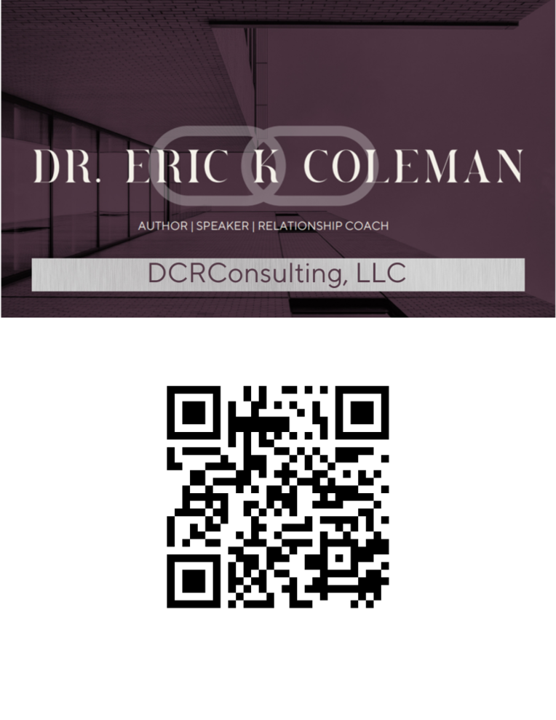
Questions and Connections
Send follow-up Questions to:
drerickencoleman@gmail.com
eric.coleman@acps.k12.va.us

